Slide 1
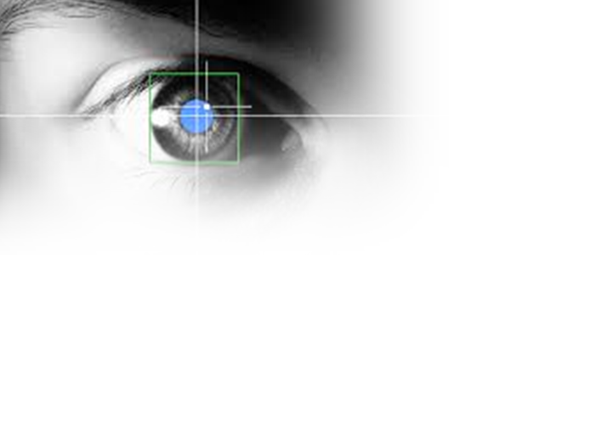

International conference on circuits and systems - iscas 2013
On the impact of packet-loss impairments on visual attention mechanisms
Judith A. Redi, Ingrid Heynderickx, Bruno Machiavello and Mylene Farias

Slide 2
Overview
Packet Loss Artifacts, visual annoyance and impact on Quality of Experience (QoE)
Visual attention and its impact on QoE
The role of visual attention in the annoyance of Packet Loss Artifacts
  A subjective experiment involving eye-tracking
  Data analysis and results
Conclusions and future research

Slide 3


Packet loss artifacts
What can we do about it?
H.264/AVC: (compressed) video information is encapsulated in NAL packets
Network errors → lost packets → error concealment
Loss in visual quality and overall QoE (e.g., Staelens 2012)
Notes:
You are probably familiar with h264 avc
What it does is that it encapsulates coded video info into a network abstraction level, so each frame is divided into slices that are then encapsulated into packets, that might get lost

Slide 4


Visual attention and qoE
The HVS minimizes the amount of visual information to process by focusing on peculiar, more informative regions, (a.k.a, salient regions)
Notes:
But we were not yet fully happy so we started looking deeply in features of the HSV to better estimate quality. What we found is that visual attention could have been useful to our purposes. Your brain bla bla
Thus the idea is that if some areas are less visible than others, you can also imagine tat distortions in those areas will be less visible. This has a number of implications. First of all for the objective computation
Then for the signal optimization and enhancement, iin view of computational cost saving you can drive most of the algorithm actions in the ROI

Slide 5
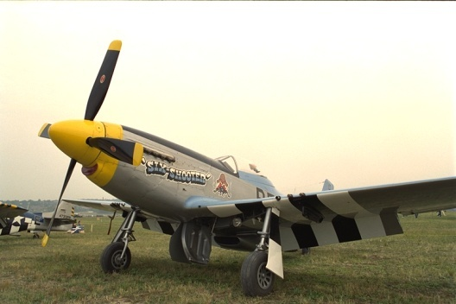

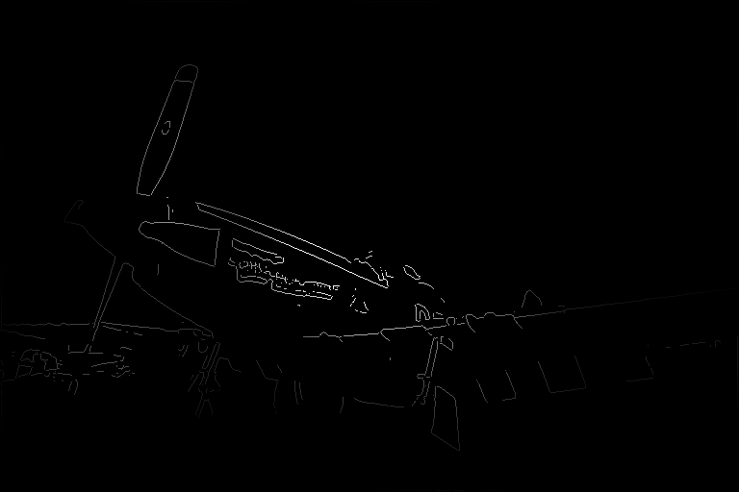

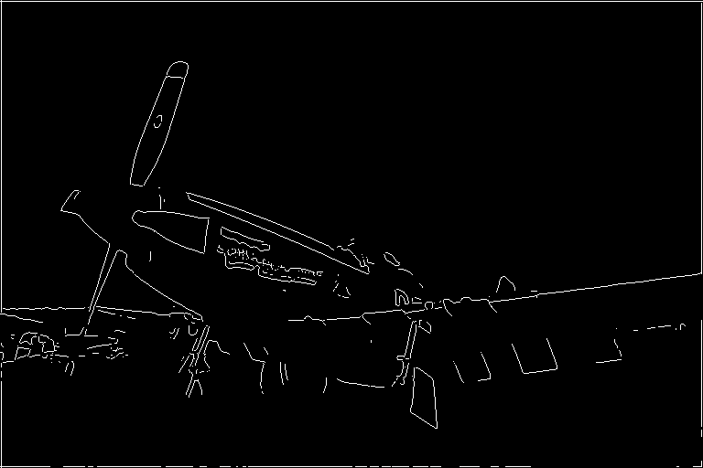
visual attention and QoE
Can packet loss artifacts distract attention?
Artifacts in the most salient regions are more annoying than those in the background (Alers 2010, Engelke 2011)
This can be modeled into objective metrics (Liu 2010)
  With mixed results for video (Le Meur 2012)
What happens to saliency with packet loss artifacts, which are sudden and strongly localized?
Eye-tracking study
original
NSS
distorted
Quality Measure
Distortion map

Slide 6






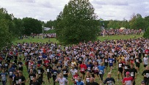




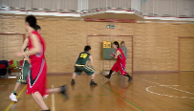

Eye-tracking study setup: stimuli
Original
720p, CVDL
h.264 encoding
PSNR>70db, 120 Mbps
Network error simulation
GOP = 4, 8, 12
Loss Ratio = 0.7%, 2.6%, 4.3% , 8.1%

Slide 7



Eye-tracking study setup: protocol
15 observers
Single Stimulus setup (ITU BT.500)
1. calibration
2. Task free pristine videos
3. Training
4. Scoring task (91 videos)
1. First video view
2. Second video view
3. “did you see imparments?”
4. How annoying were they?
Yes/no
0 100

Slide 8
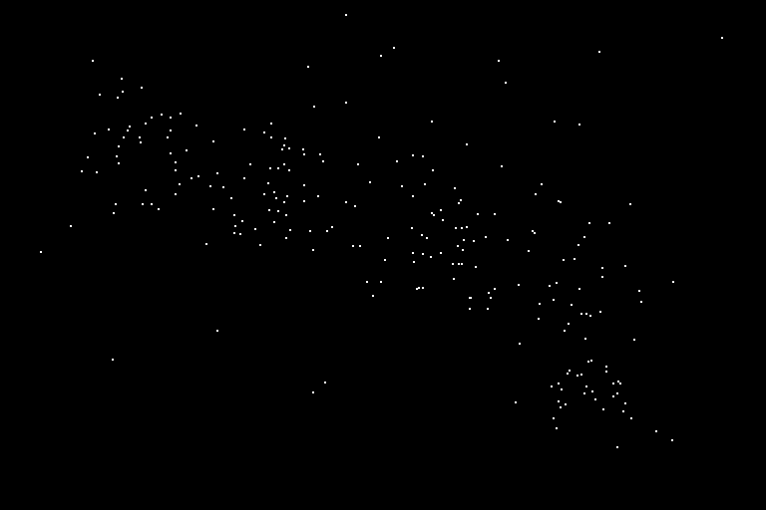

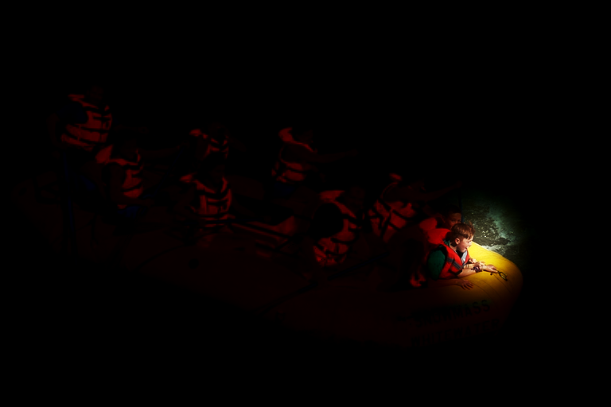
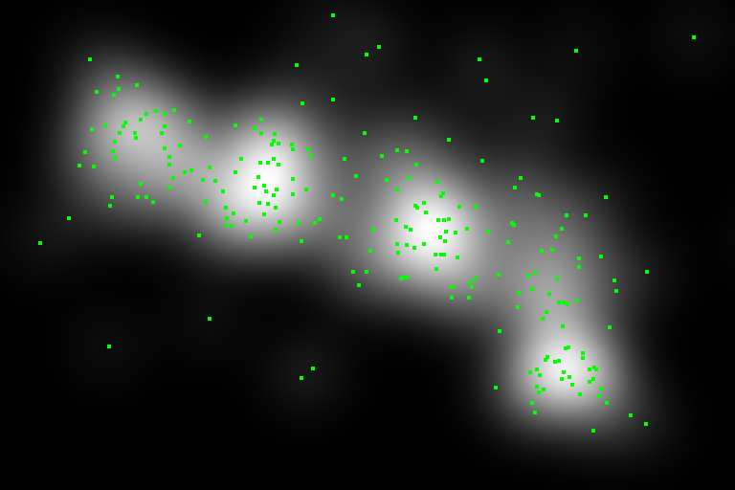



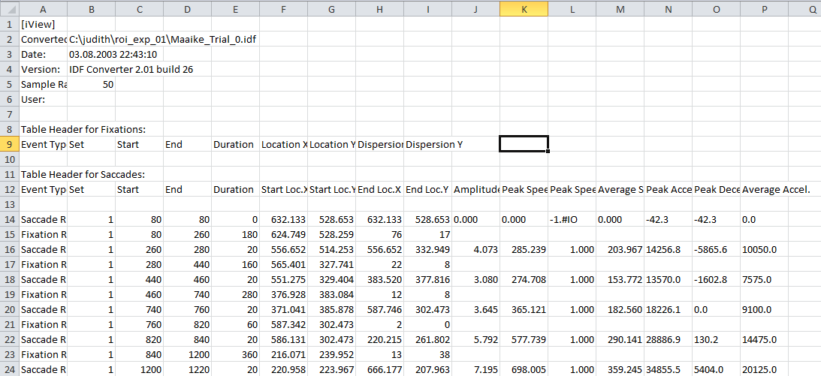

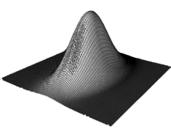

Analysis of the viewing behavior: saliency
?
SALIENCY MAP
visual representations of the probability that a location of the scene is attended by the average observer
Eye-movements
Frame fixation Map
400 ms
Fixation Map

Slide 9
Analyzing saliency to understand differences in viewing behavior
Similarity measure S∈{LCC, SSIM}
Videos divided into 3 groups
 | videos | task | #Videos
FL G1 | pristine | Free Looking | 7
SC HQ | pristine | Scoring | 7
SC LQ | impaired | Scoring | 84
SC_FL
SC^{HQ}_SC^{LQ}
UESL
FL G2 | pristine | Free Looking | 7
Upper Empirical Similarity Limit: human-human consistency

Slide 10
Results - LCC
If the shift in saliency was due to task, we would expect SC^{HQ} _ SC^{LQ} (red squares) to be closer to the UESL (green triangle) than to the SC_FL values (blue circles). That’s not the case.
Increasing mean annoyance value

Slide 11
RESULTS - SSIM

Slide 12
Impact of packet loss and annoyance on eye movements
MAV = Mean Annoyance Value

Slide 13
conclusions
Packet loss distracts attention
Shift in attention seems to be related to the annoyance provoked by the artifacts, not to the objective parameters describing the artifacts
Further work is needed towards:
  Analysing the shifts in saliency from a spatial point of view (what is becoming more salient in presence of artifacts?)
  Incorporating these results into quality metrics

Slide 14
Thank you.
Questions?
j.a.redi@tudelft.nl

Slide 15
Video properties

Slide 16
Analysis of fixations
 |  | Impairment characteristics |  | Video characteristics
 |  | GOP_size | P_loss | SI | TI
Diff_fd | Correlation | .215* | .229* | -.334** | -.600**
 | significance | .041 | .029 | .001 | .000

Slide 17


Saliency data
Saliency map was built by applying to each fixation point a gray-scale patch with Gaussian intensity distribution
  σ ~2° visual angle
k∈[1, W_{I}], l∈[1, H_{I}]
iView X RED, SensoMotoric Instruments
sampling rate: 50 Hz
spatial resolution: 0.1
gaze position accuracy: 0.5°-1.0°
Judith Alice Redi Genoa, April 23rd 2010 PhD Defense

