Slide 1
REPORT
Analysis between experiments

Slide 2
To know…
Data Analysis of three different experiments
  Experiment 1 (packet loss artefact);
  Experiment 2 (blockiness and blurriness artefacts);
  Experiment 3 (packet loss, blockiness and blurriness artefacts);
  Experiments will be called of Exp1, Exp2 and Exp3, respectively;
  Abbreviations have been used in this report
Abbreviation | Signification
Pck | Packet Loss
Blo | Blockiness
Blu | Blurriness
Partic | Participants
MOS1 | Mean Opinion Score of Experiment 1
MOS2 | Mean Opinion Score of Experiment 2
MOS3 | Mean Opinion Score of Experiment 3

Slide 3
Stepwise…
This report is divided into two cases:
  Case 1
    Analysis taking into account only original videos. In this case, all experiments have the same original video settings
  Case 2
    Analysis taking into account isolated artefacts.
    For this case, it will be divided in more 3 cases: 2.1) packet loss artefacts (Exp1 and Exp3), 2.2) only blockiness (Exp2 and Exp3) and, 2.3) only blurriness (Exp2 and Exp3)
  OBS: it won’t analyzed artefacts combined, because we are interested in those situations where there are same settings between the experiments

Slide 4
CASE 1 – Correlation
In this case we are interested to know the strength and direction of association that exists between two variables through Spearman’s correlation
Stepwise in SPSS (how it has been run…)
  DATA  SELECT CASES
    FILTERS: pck=0 and blo=0 and blu=0 and partic=1
  ANALYZE  COVARIATE  BIVARIATE
    VARIABLES: MOS1, MOS2 and MOS3
    CORRELATION COEFICIENTS: Spearman

Slide 5
CASE 1 – Correlation
Output:
  The Spearman's coefficient showed correlations from moderate to very weak between the MOS values of the experiments (p > 0.05). The table below illustrates another correlations.
weak
Moderate
p>0.05
Very weak
Notes:
H0 = não há correlação entre as MOS.
(Exp1 e Exp2): Since the sample rank correlation coefficient r = -.214, is lower than the critical value, 0.645, there is not enough evidence to reject the null hypothesis, i.e. conclude that there is not an association between the MOS’ ranks, hence they are not in agreement.
(Exp1 e Exp3): Since the sample rank correlation coefficient r = 0.595, is greater than the critical value, 0.159, there is enough evidence to reject the null hypothesis, H0, and accept H1, i.e. conclude that there is a positive association between the MOS’ ranks, hence they are in agreement.
(Exp2 e Exp3): Since the sample rank correlation coefficient r = 0.090, is lower than the critical value, 0.848, there is not enough evidence to reject the null hypothesis, H0, i.e. conclude that there is not a positive association between the MOS’ ranks, hence they are not in agreement.
NOTE: It is important to realize that statistical significance does not indicate the strength of the Spearman correlation. In fact, the statistical significance testing of the Spearman correlation does not provide you with any information about the strength of the relationship. Thus, achieving a value of p = 0.001, for example, does not mean that the relationship is stronger than if you achieved a value of p = 0.04. This is because the significance test is investigating whether you can accept or reject the null hypothesis. If you set α = 0.05, achieving a statistically significant Spearman correlation means that you can be sure that there is less than a 5% chance that the strength of the relationship you found (your rho coefficient) happened by chance if the null hypothesis were true.

Slide 6
CASE 1 – Correlation
Output:
  The Pearson's coefficient showed correlations from moderate to very weak between the MOS values of the experiments (p > 0.05). The table below illustrates another correlations.
weak
moderate
p>0.05
weak
Notes:
H₀: ρ = 0; the population correlation coefficient is equal to zero.
(Exp1 e Exp2): A Pearson's correlation was run to assess the relationship between MOS in Exp1 and Exp2. There was a weak negative correlation between MOS1 and MOS2, r = -.026, p = .956.
(Exp1 e Exp3): A Pearson's correlation was run to assess the relationship between MOS in Exp1 and Exp3. There was a moderate positive correlation between MOS1 and MOS3, r = .382, p = .398, with MOS1 explaining 16% of the variation in MOS3.
(Exp2 e Exp3): A Pearson's correlation was run to assess the relationship between MOS in Exp2 and Exp3. There was a very weak positive correlation between MOS2 and MOS3, r = .008, p = .987.

Slide 7
CASE 1 – Non Parametric tests
Stepwise in SPSS (how it has been run…)
  DATA  SELECT CASES
    FILTERS: pck=0 and blo=0 and blu=0 and partic=1
  ANALYZE  NON PARAMETRIC TESTS  2-INDEPENDENT SAMPLES
    TEST PAIRS: MOS1  MOS2; MOS1  MOS3; MOS2  MOS3
    TEST TYPE: Mann Whitney

Slide 8
CASE 1 – Non Parametric tests
Output:
  A Mann Whitney test showed that there is not statistically significant difference (p>0.05) between MOS1 and MOS3 (middle table). In another two cases, there are statistically significant difference (p<0.05) between the MOS (i.e., MOS1 and MOS2 – left table; and, MOS2 and MOS3 – right table).
p<0.05
p>0.05
p<0.05
Notes:
It was selected all videos where the setting is pck=blo=blu=0 and, it was calculated Mann Whitney Test between the experiments, considering the MOS.
MOS1 and MOS2 = A Mann-Whitney U test was run to determine if there were differences in MOS between Exp1 and Exp2. Distributions of the MOS for Exp1 and Exp2 were similar, as assessed by visual inspection. Median MOS was statistically significantly higher in Exp2 (10.71) than in Exp1 (4.29), U = 2, z = -2.875, p = .004.
MOS1 and MOS3 = Mann-Whitney U test was run to determine if there were differences in MOS between Exp1 and Exp3. Distributions of the MOS for Exp1 and Exp3 were similar, as assessed by visual inspection. Median MOS for Exp1 (8.29) and Exp3 (6.71) was not statistically significantly different, U = 19, z = -0.706, p = .480.
MOS2 and MOS3 = A Mann-Whitney U test was run to determine if there were differences in MOS between Exp2 and Exp3. Distributions of the MOS for Exp2 and Exp3 were similar, as assessed by visual inspection. Median MOS was statistically significantly higher in Exp2 (11.00) than in Exp3 (4.00), U = .0, z = -3.134, p = .002.

Slide 9
CASE 1 – Graphs
Stepwise in SPSS (how it has been run…)
  DATA  SELECT CASES
    FILTERS: pck=0 and blo=0 and blu=0
  DATA  SPLIT FILE
    COMPARE GROUPS

Slide 10
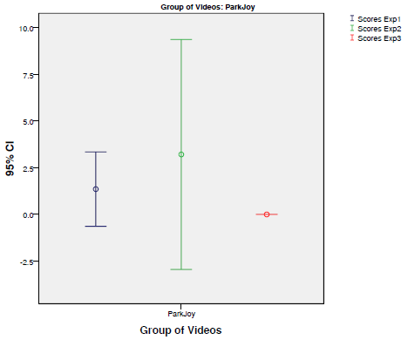
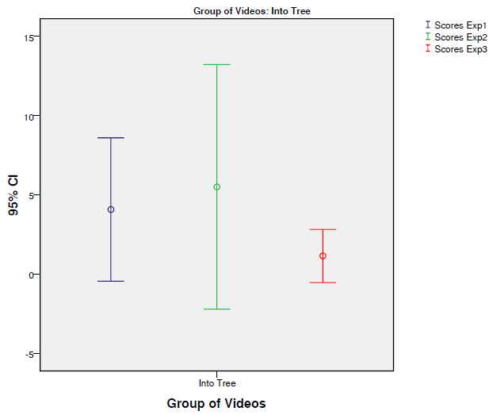
CASE 1 – Graphs
Graphs

Slide 11


CASE 1 – Graphs
Graphs

Slide 12
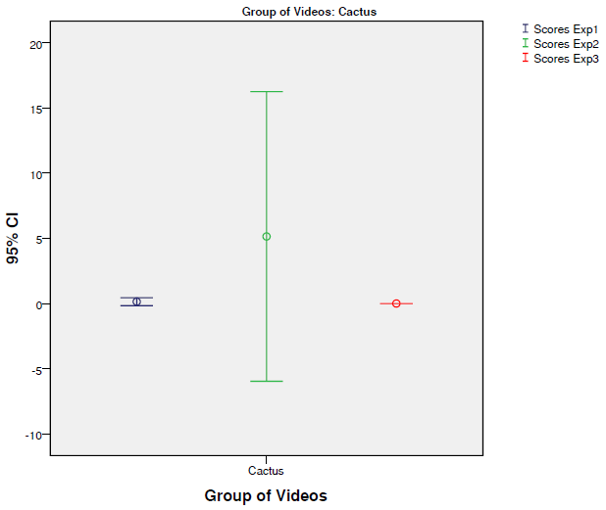

CASE 1 – Graphs
Graphs

Slide 13

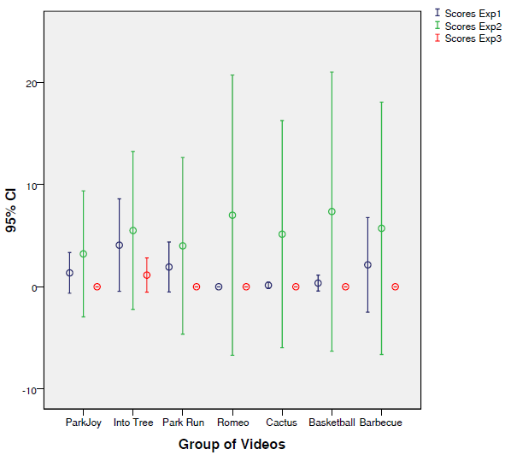
CASE 1 – Graphs
Graphs

Slide 14
CASE 2.1 – Correlation
Calculates Spearman’s correlation of the independent of settings, i.e., taking into account only artefact (packet loss) in Exp1 and Exp3
Stepwise in SPSS (how it has been run…)
  DATA  SELECT CASES
    FILTERS: pck=8.1 and blo=0 and blu=0 and partic=1
  ANALYZE  COVARIATE  BIVARIATE
    VARIABLES: MOS1 and MOS3
    CORRELATION COEFICIENTS: Spearman

Slide 15
CASE 2.1 – Correlation
Output:
  The Spearman's coefficient showed that there is a moderate correlation of the MOS1 and MOS3 values between the experiments but, there are not statistically significant difference (p > 0.05)
Moderate
p>0.05
Notes:
A Spearman's rank-order correlation was run to assess the relationship between MOS1 and MOS3 in the experiments taking into account Packet Loss artefacts. There was a moderate positive correlation between MOS1 and MOS3, r_{s} = .536, p > .05.
H₀ = não há correlação entre as MOS.
(Exp1 e Exp3): Since the sample rank correlation coefficient r = .536, is greater than the critical value, 0.215, there is enough evidence to reject the null hypothesis, i.e. conclude that there is an association between the MOS’ ranks, hence they are in agreement.

Slide 16
CASE 2.1 – Correlation
Output:
  A Pearson's correlation was run to assess the relationship between MOS in Exp1 and Exp3. There was a strong positive correlation between MOS1 and MOS3, r = .842, p = .018 with MOS1 explained 71% of the variability in MOS3.
strong
p= .018
Notes:
H₀: ρ = 0; the population correlation coefficient is equal to zero.

Slide 17
CASE 2.1 – Non Parametric tests
Stepwise in SPSS (how it has been run…)
  DATA  SELECT CASES
    FILTERS: pck=8.1 and blo=0 and blu=0 and partic=1
  ANALYZE  NON PARAMETRIC TESTS  2-INDEPENDENT SAMPLES
    TEST PAIRS: MOS1  MOS3
    TEST TYPE: Mann Whitney

Slide 18
CASE 2.1 – Non Parametric tests
Output:
  A Mann Whitney test showed that the observed difference between both MOS are significant (p<0.05). Thus, we might assume that the packet loss artefact has caused a significant increase in scores of Exp1 than Exp3.
p<0.05
Notes:
MOS1 and MOS3 = A Mann-Whitney U test was run to determine if there were differences in MOS between Exp1 and Exp3. Distributions of the MOS for Exp1 and Exp3 were similar, as assessed by visual inspection. Median MOS was statistically significantly higher in Exp1 (10.57) than in Exp3 (4.43), U = 3, z = -2.747, p = .006.

Slide 19
CASE 2.1 – Graphs
Stepwise in SPSS (how it has been run…)
  DATA  SELECT CASES
    FILTERS: pck=8.1 and blo=0 and blu=0
  DATA  SPLIT FILE
    COMPARE GROUPS

Slide 20
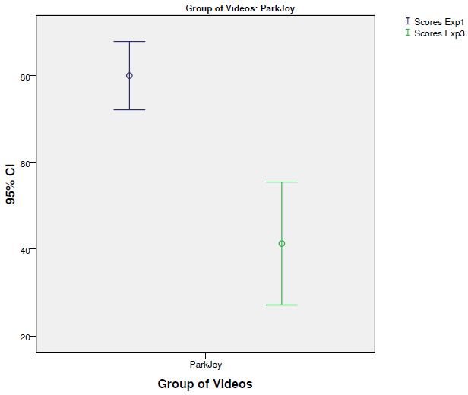
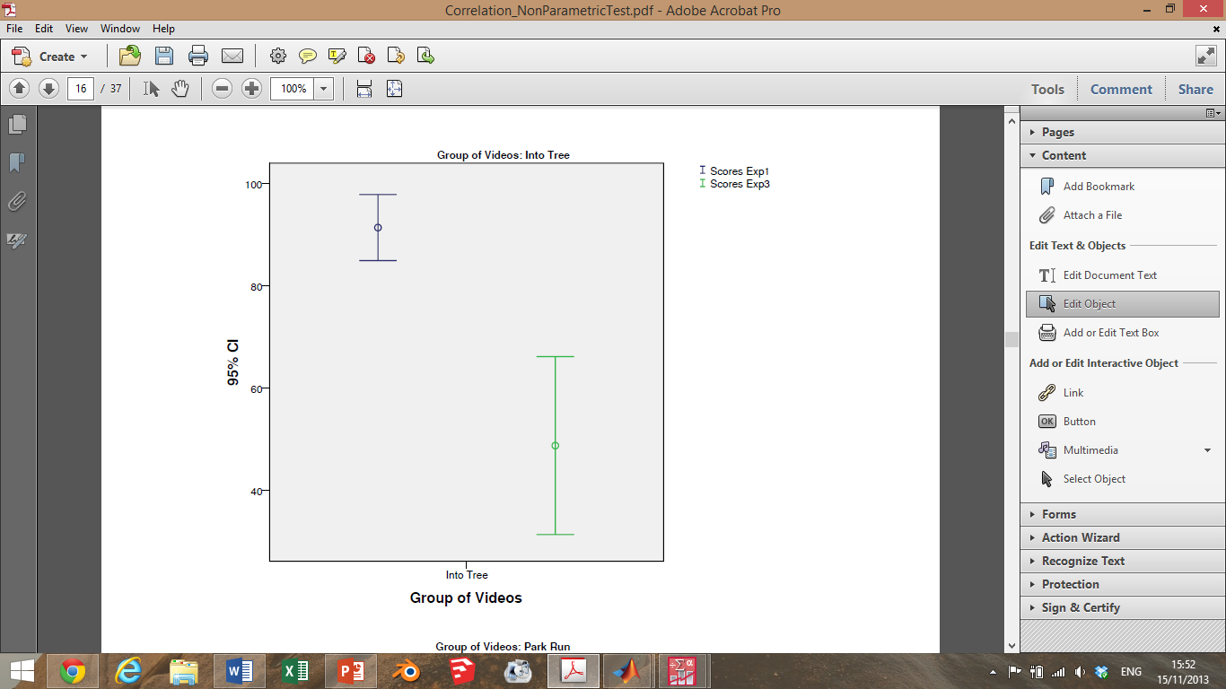
CASE 2.1 – Graphs
Graphs

Slide 21


CASE 2.1 – Graphs
Graphs

Slide 22


CASE 2.1 – Graphs
Graphs

Slide 23
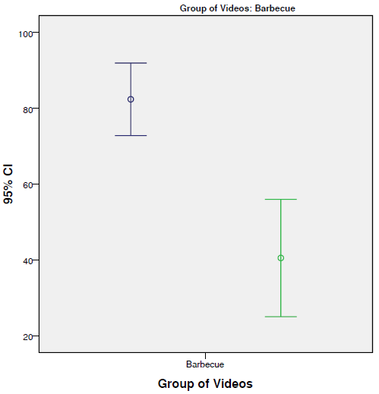
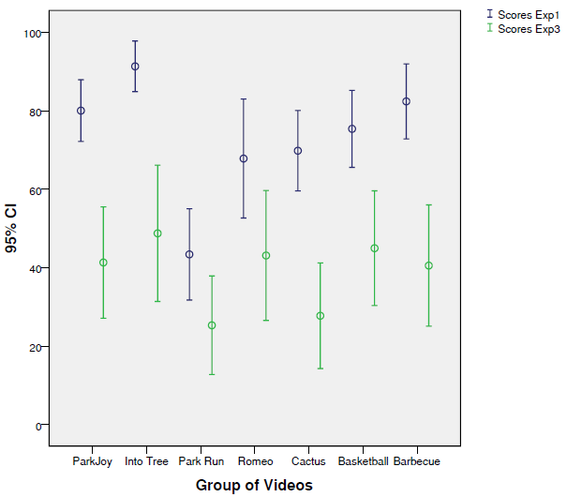
CASE 2.1 – Graphs
Graphs

Slide 24
CASE 2.2 – Correlation
Calculates Spearman’s correlation of the independent of settings, i.e., taking into account only artefact (blockiness) in Exp2 and Exp3
Stepwise in SPSS (how it has been run…)
  DATA  SELECT CASES
    FILTERS: pck=0 and blo=0.6 and blu=0 and partic=1
  ANALYZE  COVARIATE  BIVARIATE
    VARIABLES: MOS2 and MOS3
    CORRELATION COEFICIENTS: Spearman

Slide 25
CASE 2.2 – Correlation
Output:
  Spearman's correlation coefficient was run to determine the relationship of blockiness artefact between Exp2 and Exp3. There was a moderate, positive correlation, r_{s}=0.536, between MOS2 and MOS3, which was not statistically significant (p > 0.05)
moderate
p>0.05
Notes:
H₀ = não há correlação entre as MOS.
(Exp1 e Exp3): Since the sample rank correlation coefficient r = .536, is greater than the critical value, 0.215, there is enough evidence to reject the null hypothesis, i.e. conclude that there is an association between the MOS’ ranks, hence they are in agreement.

Slide 26
CASE 2.2 – Correlation
Output:
  A Pearson's correlation was run to assess the relationship between MOS in Exp2 and Exp3. There was a moderate positive correlation between MOS2 and MOS3, r = .482, p = .274 with MOS1 explained 23% of the variability in MOS3.
moderate
p= .274
Notes:
H₀: ρ = 0; the population correlation coefficient is equal to zero.

Slide 27
CASE 2.2 – Non Parametric tests
Stepwise in SPSS (how it has been run…)
  DATA  SELECT CASES
    FILTERS: pck=0 and blo=0.6 and blu=0 and partic=1
  ANALYZE  NON PARAMETRIC TESTS  2-INDEPENDENT SAMPLES
    TEST PAIRS: MOS2  MOS3
    TEST TYPE: Mann Whitney

Slide 28
CASE 2.2 – Non Parametric tests
Output:
  A Mann Whitney test showed that the observed difference between both MOS are significant (p<0.05). Thus, we might assume that the blockiness artefact has caused a significant increase in scores of Exp2 than Exp3.
p<0.05
Notes:
MOS2 and MOS3 = A Mann-Whitney U test was run to determine if there were differences in MOS between Exp2 and Exp3 in the blockiness artefacts analyses. Median MOS was statistically significantly in Exp2 (9.86) than in Exp3 (5.14), U = 8, z = -2.108, p = .035.

Slide 29
CASE 2.2 – Graphs
Stepwise in SPSS (how it has been run…)
  DATA  SELECT CASES
    FILTERS: pck=0 and blo=0.6 and blu=0
  DATA  SPLIT FILE
    COMPARE GROUPS

Slide 30
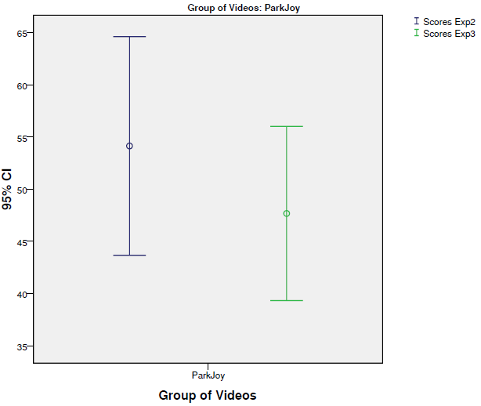
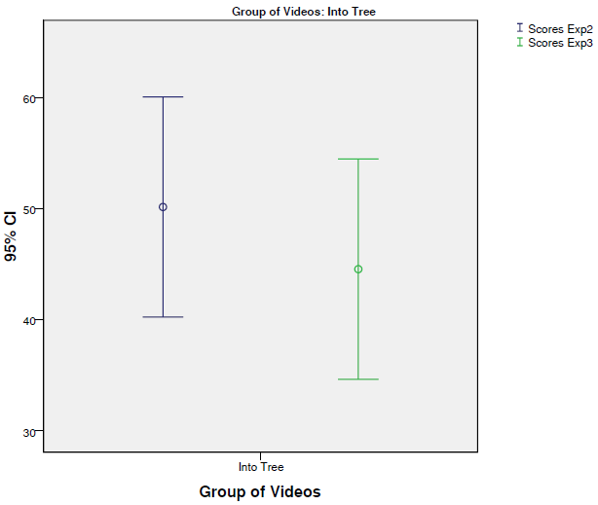
CASE 2.2 – Graphs
Graphs

Slide 31
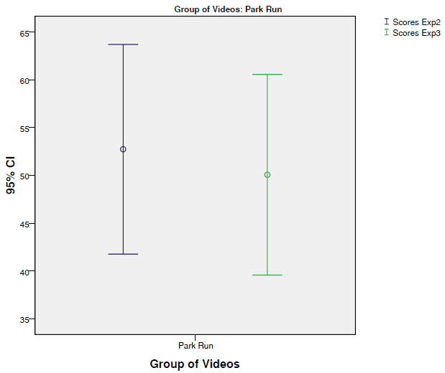
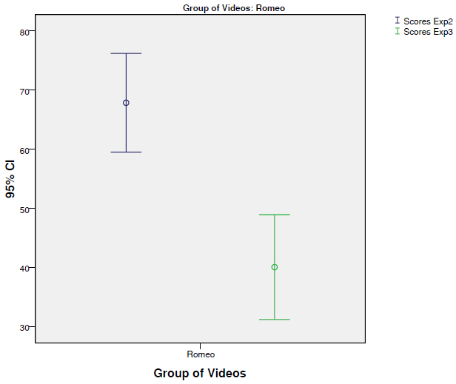
CASE 2.2 – Graphs
Graphs

Slide 32


CASE 2.2 – Graphs
Graphs

Slide 33
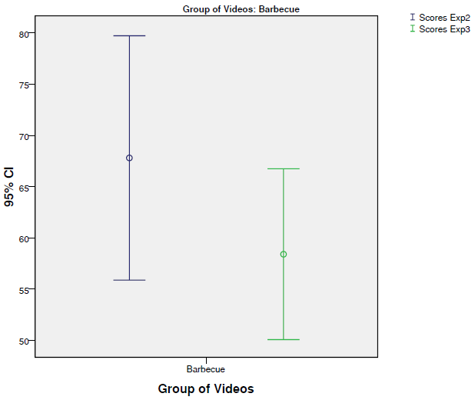
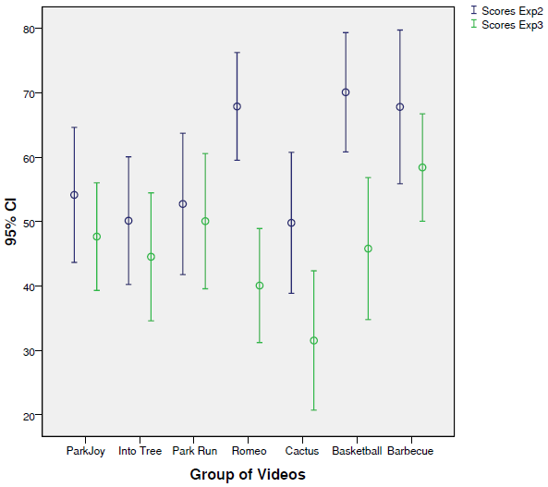
CASE 2.2 – Graphs
Graphs

Slide 34
CASE 2.3 – Correlation
Calculates Spearman’s correlation of the independent of settings, i.e., taking into account only artefact (blurriness) in Exp2 and Exp3
Stepwise in SPSS (how it has been run…)
  DATA  SELECT CASES
    FILTERS: pck=0 and blo=0 and blu=0.6 and partic=1
  ANALYZE  COVARIATE  BIVARIATE
    VARIABLES: MOS2 and MOS3
    CORRELATION COEFICIENTS: Spearman

Slide 35
CASE 2.3 – Correlation
Output:
  Spearman's coefficient correlation was run to determine the relationship of blurriness artefacts between Exp2 and Exp3. There was a strong, positive correlation, r_{s}=0.857, between MOS2 and MOS3, which was statistically significant (p < 0.05)
Very strong
p<0.05
Notes:
H₀ = não há correlação entre as MOS.
(Exp2 e Exp3): Since the sample rank correlation coefficient r = .857, is greater than the critical value, 0.014, there is enough evidence to reject the null hypothesis, i.e. conclude that there is an association between the MOS’ ranks, hence they are in agreement.

Slide 36
CASE 2.3 – Correlation
Output:
  A Pearson's correlation was run to assess the relationship between MOS in Exp2 and Exp3. There was a strong positive correlation between MOS2 and MOS3, r = .872, p = .011 with MOS2 explained 76% of the variability in MOS3.
strong
p= .274
Notes:
H₀: ρ = 0; the population correlation coefficient is equal to zero.

Slide 37
CASE 2.3 – Non Parametric tests
Stepwise in SPSS (how it has been run…)
  DATA  SELECT CASES
    FILTERS: pck=0 and blo=0 and blu=0.6 and partic=1
  ANALYZE  NON PARAMETRIC TESTS  2-INDEPENDENT SAMPLES
    TEST PAIRS: MOS2  MOS3
    TEST TYPE: Mann Whitney

Slide 38
CASE 2.3 – Non Parametric tests
Output:
  A Mann Whitney test showed that the observed difference between both MOS are not significant (p>0.05). Thus, we might assume that the blurriness artefact has not caused a significant increase in scores of Exp2 than Exp3.
p>0.05
Notes:
MOS2 and MOS3 = A Mann-Whitney U test was run to determine if there were differences in MOS between Exp2 and Exp3 to blurriness artefacts. Median MOS was equal (it is not statistically significantly) in Exp2 (7.50) and Exp3 (7.50), U = 24.50, z = .000, p = 1.

Slide 39
CASE 2.3 – Graphs
Stepwise in SPSS (how it has been run…)
  DATA  SELECT CASES
    FILTERS: pck=0 and blo=0 and blu=0.6
  DATA  SPLIT FILE
    COMPARE GROUPS

Slide 40
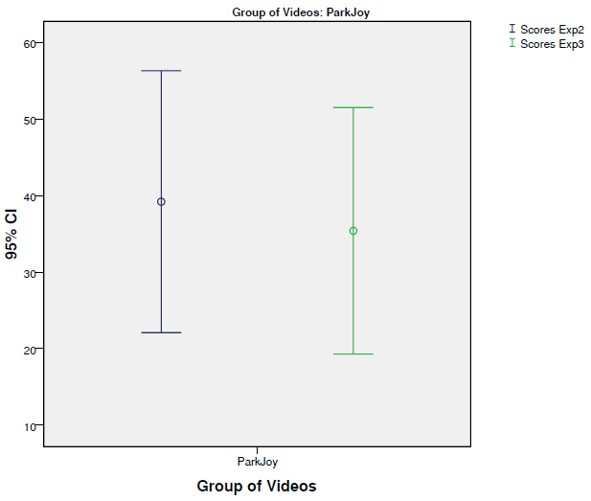

CASE 2.3 – Graphs
Graphs

Slide 41
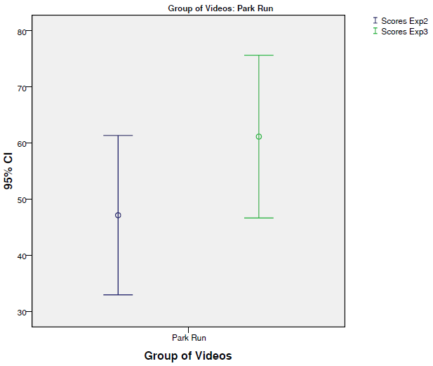
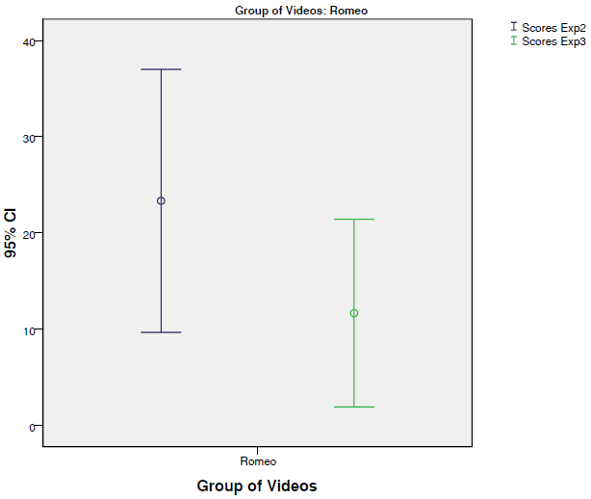
CASE 2.3 – Graphs
Graphs

Slide 42
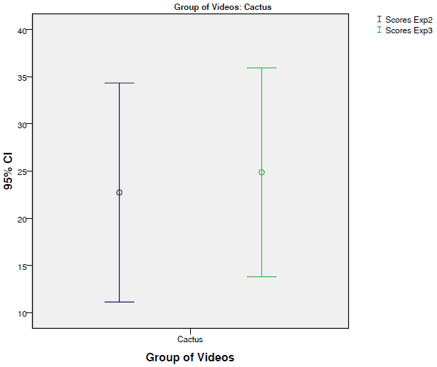
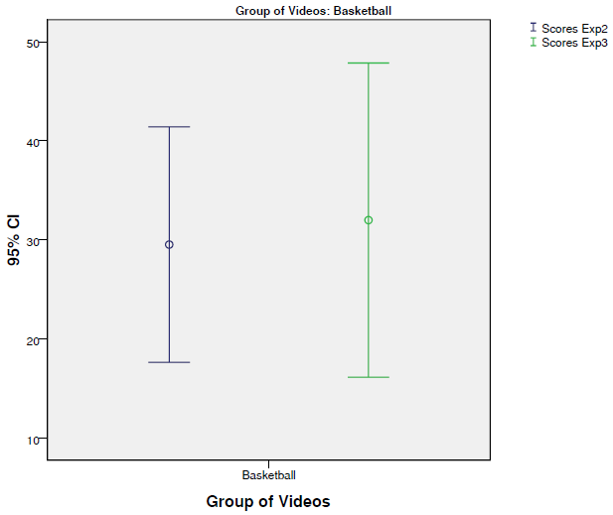
CASE 2.3 – Graphs
Graphs

Slide 43
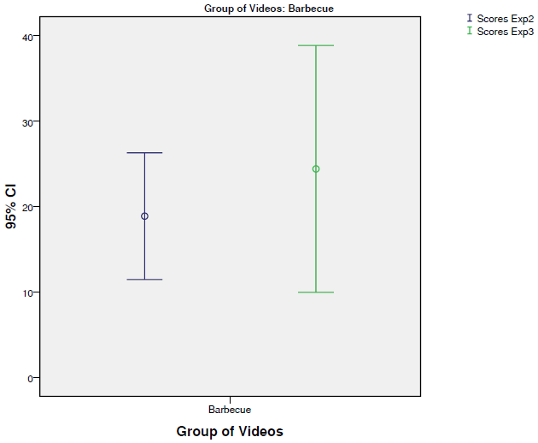
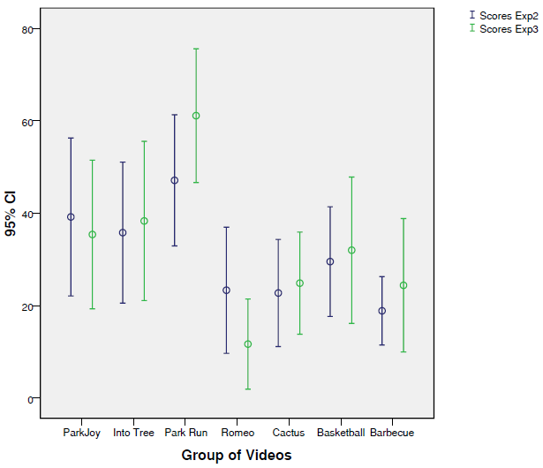
CASE 2.3 – Graphs
Graphs

Slide 44
Correlation to MOS for the videos present in both Exp. 1 and 3
Stepwise in SPSS (how it has been run…)
  DATA  SELECT CASES
    FILTERS: (pck=8.1 AND blo=0 AND blu=0 AND partic=1) OR (pck=0 AND blo=0 AND blu=0 AND partic=1)
  ANALYZE  COVARIATE  BIVARIATE
    VARIABLES: MOS1 and MOS3
    CORRELATION COEFICIENTS: Spearman

Slide 45
Correlation MOS for the videos present in both Exp. 1 and 3
Output (pck=blo=blu=0 AND pck=8.1, blo=blu=0)
  Spearman's coefficient correlation was run to determine the relationship between all videos present in Exp.1 and Exp3 is strong and positive correlation, r_{s}=0.893, and statistically different significant (p < 0.05).
Very strong
p<0.05
p<0.05
Very strong
Notes:
H₀ = não há correlação entre as MOS.
(Exp1 e Exp3): Since the sample rank correlation coefficient r =.893, is greater than the critical value, .000, there is enough evidence to reject the null hypothesis, i.e. conclude that there is an association between the MOS’ ranks, hence they are in agreement.

Slide 46
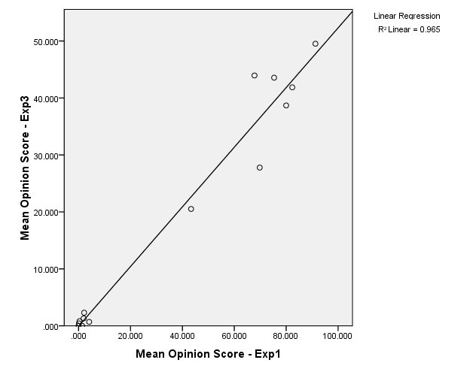
Exp. 1 and Exp.3 – Overall Correlation – Packet Loss
Scatters plot shows the relationship between MOS1 and MOS3 (R² = 0.965).
T-Test between MOS1 and MOS3

Slide 47
Correlation to MOS for the videos present in both Exp. 2 and 3
Stepwise in SPSS (how it has been run…)
  DATA  SELECT CASES
    FILTERS: (pck=0 AND blo=0.6 AND blu=0 AND partic=1) OR (pck=0 AND blo=0 AND blu=0 AND partic=1)
  ANALYZE  COVARIATE  BIVARIATE
    VARIABLES: MOS2 and MOS3
    CORRELATION COEFICIENTS: Spearman

Slide 48
Correlation to MOS for the videos present in both Exp. 2 and 3
Output (pck=blo=blu=0 AND blo=0.6, pck=blu=0)
  Spearman's coefficient correlation was run to determine the relationship between all videos present in Exp.2 and Exp3 is strong and positive correlation, r_{s}=0.832, and statistically different significant (p < 0.05).
Very strong
p<0.05
Very strong
p<0.05
Notes:
H₀ = não há correlação entre as MOS.
(Exp2 e Exp3): Since the sample rank correlation coefficient r =.832, is greater than the critical value, .000, there is enough evidence to reject the null hypothesis, i.e. conclude that there is an association between the MOS’ ranks, hence they are in agreement.

Slide 49
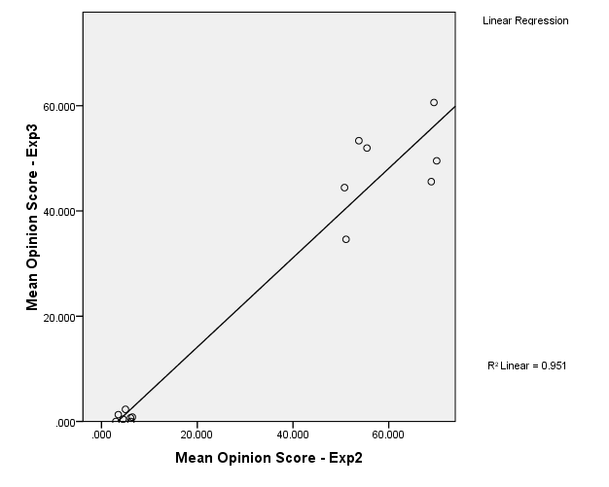
Exp. 2 and Exp.3 – Overall Correlation – Blockiness
Scatters plot shows the relationship between MOS2 and MOS3 (R² = 0.951).
T-Test between MOS2 and MOS3

Slide 50
Correlation to MOS for the videos present in both Exp. 2 and 3
Stepwise in SPSS (how it has been run…)
  DATA  SELECT CASES
    FILTERS: (pck=0 AND blo=0 AND blu=0.6 AND partic=1) OR (pck=0 AND blo=0 AND blu=0 AND partic=1)
  ANALYZE  COVARIATE  BIVARIATE
    VARIABLES: MOS2 and MOS3
    CORRELATION COEFICIENTS: Spearman

Slide 51
Correlation to MOS for the videos present in both Exp. 2 and 3
Output (pck=blo=blu=0 AND blu=0.6, pck=blo=0)
  Spearman's coefficient correlation was run to determine the relationship between all videos present in Exp.2 and Exp3 is strong and positive correlation, r_{s}=0.871, and statistically different significant (p < 0.05).
Very strong
p<0.05
Very strong
p<0.05
Notes:
H₀ = não há correlação entre as MOS.
(Exp2 e Exp3): Since the sample rank correlation coefficient r =.871, is greater than the critical value, .000, there is enough evidence to reject the null hypothesis, i.e. conclude that there is an association between the MOS’ ranks, hence they are in agreement.

Slide 52
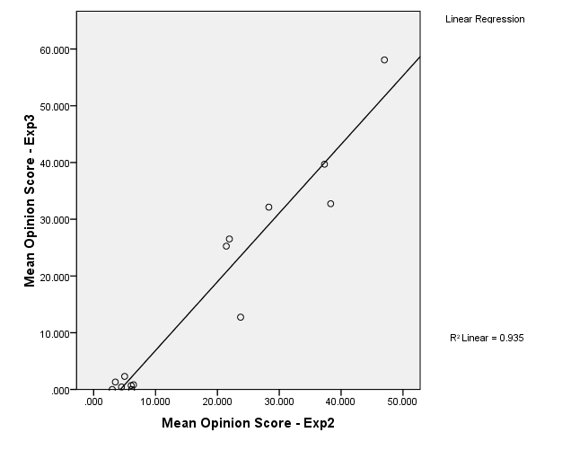
Exp. 2 and Exp.3 – Overall Correlation – Blurriness
Scatters plot shows the relationship between MOS2 and MOS3 (R² = 0.935).
T-Test between MOS2 and MOS3

Slide 53
Correlation to MOS for the videos present in both Exp. 2 and 3
Stepwise in SPSS (how it has been run…)
  DATA  SELECT CASES
    FILTERS: (pck=0 AND blo=0 AND blu=0.6 AND partic=1) OR (pck=0 AND blo=0 AND blu=0 AND partic=1) OR (pck=0 AND blo=0.6 AND blu=0 AND partic=1)
  ANALYZE  COVARIATE  BIVARIATE
    VARIABLES: MOS2 and MOS3
    CORRELATION COEFICIENTS: Spearman

Slide 54
Correlation to MOS for the videos present in both Exp. 2 and 3
Output (pck=blo=blu=0 AND blu=0.6, pck=blo=0 AND blu=pck=0, blo=0.6)
  Spearman's coefficient correlation was run to determine the relationship between all videos present in Exp.2 and Exp3 is strong and positive correlation, r_{s}=0.911, and statistically different significant (p < 0.05).
Very strong
p<0.05
Very strong
p<0.05
Notes:
H₀ = There is no correlation between the means
(Exp2 e Exp3): Since the sample rank correlation coefficient r =.911, is greater than the critical value, .000, there is enough evidence to reject the null hypothesis, i.e. conclude that there is an association between the MOS’ ranks, hence they are in agreement.

Slide 55
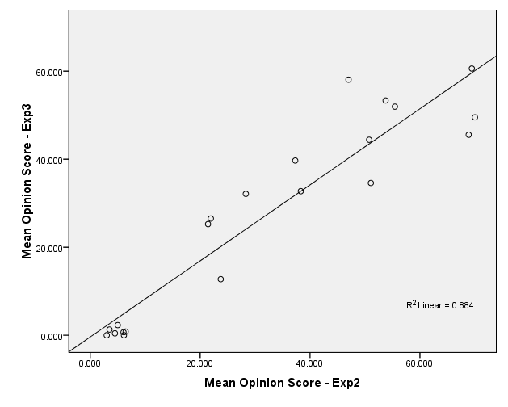
Exp. 2 and Exp.3 – Overall Correlation – Orig + blo + blu
Scatters plot shows the relationship between MOS2 and MOS3 (R² = 0.884).
T-Test between MOS2 and MOS3

Slide 56
Experiments – T-Test between MOS’
Stepwise in SPSS (how it has been run…)
  Case 1: check whether the distribution of the MOS values across all the videos common to the Exp.1 and Exp.3 (Correlation can be seen in the slide 41)
  Case 2: check whether the distribution of the MOS values across all the videos common to the Exp.2 and Exp.3 (blockiness) - (Correlation can be seen in the slide 43)
  Case 3: check whether the distribution of the MOS values across all the videos common to the Exp.2 and Exp.3 (blurriness) - (Correlation can be seen in the slide 45)

Slide 57
Experiments – T-Test between MOS’ (CASE 1)
Stepwise in SPSS (how it has been run…)
  DATA  SELECT CASES (each time)
    FILTERS: (pck=0 AND blo=0 AND blu=0 AND partic=1) OR (pck=8.1 AND blo=0 AND blu=0 AND partic=1)
    FILTERS: (pck=0 AND blo=0 AND blu=0 AND partic=1) OR (pck=0 AND blo=0.6 AND blu=0 AND partic=1)
    FILTERS: (pck=0 AND blo=0 AND blu=0 AND partic=1) OR (pck=0 AND blo=0 AND blu=0.6 AND partic=1)
    FILTERS: (pck=0 AND blo=0 AND blu=0 AND partic=1) OR (pck=0 AND blo=0 AND blu=0.6 AND partic=1) OR (pck=0 AND blo=0.6 AND blu=0 AND partic=1)
  ANALYZE  NON PARAMETRIC TESTS  2-INDEPENDENT SAMPLES
    TEST PAIRS: MOS1  MOS3
    TEST PAIRS: MOS2  MOS3
    TEST TYPE: Mann Whitney
Notes:
USE ALL.
COMPUTE filter_$=((seq=1 AND partic=1) OR (seq=4 AND partic=1)).
VARIABLE LABEL filter_$ '(seq=1 AND partic=1) OR (seq=4 AND partic=1) (FILTER)'.
VALUE LABELS filter_$ 0 'Not Selected' 1 'Selected'.
FORMAT filter_$ (f1.0).
FILTER BY filter_$.
EXECUTE.
NPAR TESTS
/M-W= mos BY exp(1 3)
/MISSING ANALYSIS.

Slide 58
Experiments – T-Test between MOS’ (CASE 1)
Output (pck=blo=blu=0 AND pck=8.1, blo=0, blu=0)
  A Mann-Whitney U test was run to determine if there were differences in MOS between Exp1 and Exp3 to all videos (original and packet loss). Median MOS was not statistically significantly in Exp1 (16.43) than in Exp3 (12.57), U = 71, z = -1.241, p = .215.
p>0.05

Slide 59
Experiments – T-Test between MOS’ (CASE 2)
Output (pck=blo=blu=0 AND pck=0, blo=0.6, blu=0)
  A Mann-Whitney U test was run to determine if there were differences in MOS between Exp2 and Exp3 to all videos (original and blockiness). Median MOS was not statistically significantly in Exp2 (17.43) than in Exp3 (11.57), U = 57, z = -1.884, p = .060.
p>0.05

Slide 60
Experiments – T-Test between MOS’ (CASE 3)
Output (pck=blo=blu=0 AND pck=0, blo=0, blu=0.6)
  A Mann-Whitney U test was run to determine if there were differences in MOS between Exp2 and Exp3 to all videos (original and blurriness). Median MOS was not statistically significantly in Exp2 (16.25) than in Exp3 (12.75), U = 73.50, z = -1.126, p = .260.
p>0.05

Slide 61
Experiments – T-Test between MOS’ (CASE 3)
Output (pck=blo=blu=0 AND pck=0, blo=0, blu=0.6, AND pck=blu=0, blo=0.6)
  A Mann-Whitney U test was run to determine if there were differences in MOS between Exp2 and Exp3 to all videos (original, blockiness and blurriness). Median MOS was not statistically significantly in Exp2 (23.50) than in Exp3 (19.50), U = 178.50, z = -1.057, p = .291.
p>0.05

Slide 62
Exp. 1 and Exp.3 – T-Test between Scores’ – Packet Loss
Stepwise in SPSS (how it has been run…)
  DATA  SELECT CASES
    FILTERS: (pck=0 AND blo=0 AND blu=0) OR (pck=8.1 AND blo=0 AND blu=0)
  ANALYZE  NON PARAMETRIC TESTS  2-INDEPENDENT SAMPLES
    TEST PAIRS: scores1  scores3
    TEST TYPE: Mann Whitney
Notes:
USE ALL.
COMPUTE filter_$=((seq=1) OR (seq=4)).
VARIABLE LABEL filter_$ '(seq=1) OR (seq=4) (FILTER)'.
VALUE LABELS filter_$ 0 'Not Selected' 1 'Selected'.
FORMAT filter_$ (f1.0).
FILTER BY filter_$.
EXECUTE.
NPAR TESTS
/M-W= scores BY exp(1 3)
/MISSING ANALYSIS.

Slide 63
Exp. 1 and Exp.3 – T-Test between Scores’ – Packet Loss
Output (pck=blo=blu=0 AND pck=8.1, blo=blu=0)
  A Mann-Whitney U test was run to determine if there were differences in scores between Exp1 and Exp3 to all videos (original and packet loss). Median scores was statistically significantly in Exp1 (292.11) than in Exp3 (239.65), U = 25164, z = -4.0.86, p = .000.
p<0.05

Slide 64
Exp. 1 and Exp.3 – T-Test between Scores’ – Packet Loss
Stepwise in SPSS (how it has been run…)
  DATA  SELECT CASES
    FILTERS: (pck=0 AND blo=0 AND blu=0) OR (pck=8.1 AND blo=0 AND blu=0)
    OBS: the filter has been selected for each video (separately)
  ANALYZE  NON PARAMETRIC TESTS  2-INDEPENDENT SAMPLES
    TEST PAIRS: scores1  scores3
    TEST TYPE: Mann Whitney
Notes:
USE ALL.
COMPUTE filter_$=((seq=1 AND content=1) OR (seq=4 AND content=1)).
VARIABLE LABEL filter_$ '(seq=1 AND content=1) OR (seq=4 AND content=1) (FILTER)'.
VALUE LABELS filter_$ 0 'Not Selected' 1 'Selected'.
FORMAT filter_$ (f1.0).
FILTER BY filter_$.
EXECUTE.
NPAR TESTS
/M-W= scores BY exp(1 3)
/MISSING ANALYSIS.

Slide 65
Exp. 1 and Exp.3 – T-Test between Scores’ – Packet Loss
Output (pck=blo=blu=0 AND pck=8.1, blo=blu=0)
  Mann-Whitney Test:
  Park Joy Into Trees
p>0.05
p>0.05
Notes:
A Mann-Whitney U test was run to determine if there were differences in scores between Exp1 and Exp3 to Park Joy (original and packet loss). Median scores was not statistically significantly in Exp1 (43.23) than in Exp3 (34.01), U = 483.50, z = -1.892, p = .059.
A Mann-Whitney U test was run to determine if there were differences in scores between Exp1 and Exp3 to Into Tress (original and packet loss). Median scores was not statistically significantly in Exp1 (43.52) than in Exp3 (33.84), U = 475.50, z = -1.952, p = .051.

Slide 66
Exp. 1 and Exp.3 – T-Test between Scores’ – Packet Loss
Output (pck=blo=blu=0 AND pck=8.1, blo=blu=0)
  Mann-Whitney Test:
  Park Run Romeo & Juliet
p>0.05
p>0.05
Notes:
A Mann-Whitney U test was run to determine if there were differences in scores between Exp1 and Exp3 to Park Joy (original and packet loss). Median scores was not statistically significantly in Exp1 (42.55) than in Exp3 (34.42), U = 502.50, z = -1.661, p = .097.
A Mann-Whitney U test was run to determine if there were differences in scores between Exp1 and Exp3 to Into Tress (original and packet loss). Median scores was not statistically significantly in Exp1 (40.68) than in Exp3 (35.57), U = 555, z = -1.067, p = .0286.

Slide 67
Exp. 1 and Exp.3 – T-Test between Scores’ – Packet Loss
Output (pck=blo=blu=0 AND pck=8.1, blo=blu=0)
  Mann-Whitney Test:
  Cactus Basketball
p>0.05
p>0.05
Notes:
A Mann-Whitney U test was run to determine if there were differences in scores between Exp1 and Exp3 to Park Joy (original and packet loss). Median scores was not statistically significantly in Exp1 (42.64) than in Exp3 (34.37), U = 500, z = -1.698, p = .090.
A Mann-Whitney U test was run to determine if there were differences in scores between Exp1 and Exp3 to Into Tress (original and packet loss). Median scores was not statistically significantly in Exp1 (41.70) than in Exp3 (34.95), U = 526.50, z = -1.385, p = .166.

Slide 68
Exp. 1 and Exp.3 – T-Test between Scores’ – Packet Loss
Output (pck=blo=blu=0 AND pck=8.1, blo=blu=0)
  Mann-Whitney Test:
  Barbecue
p>0.05
Notes:
A Mann-Whitney U test was run to determine if there were differences in scores between Exp1 and Exp3 to Park Joy (original and packet loss). Median scores was not statistically significantly in Exp1 (42.48) than in Exp3 (34.47), U = 504.50, z = -1.644, p = .100.

Slide 69
Exp. 1 and Exp.3 – T-Test between Scores’ – Packet Loss
Stepwise in SPSS (how it has been run…)
  DATA  SELECT CASES
    FILTERS: (pck=0 AND blo=0 AND blu=0)
    FILTERS: (pck=8.1 AND blo=0 AND blu=0)
    OBS: the filter has been selected for each video (separately)
  ANALYZE  NON PARAMETRIC TESTS  2-INDEPENDENT SAMPLES
    TEST PAIRS: score1  score3
    TEST TYPE: Mann Whitney
Notes:
USE ALL.
COMPUTE filter_$=((seq=1 AND content=1)).
VARIABLE LABEL filter_$ '(seq=1 AND content=1) (FILTER)'.
VALUE LABELS filter_$ 0 'Not Selected' 1 'Selected'.
FORMAT filter_$ (f1.0).
FILTER BY filter_$.
EXECUTE.
NPAR TESTS
/M-W= scores BY exp(1 3)
/MISSING ANALYSIS.
USE ALL.
COMPUTE filter_$=((seq=4 AND content=1)).
VARIABLE LABEL filter_$ '(seq=4 AND content=1) (FILTER)'.
VALUE LABELS filter_$ 0 'Not Selected' 1 'Selected'.
FORMAT filter_$ (f1.0).
FILTER BY filter_$.
EXECUTE.
NPAR TESTS
/M-W= scores BY exp(1 3)
/MISSING ANALYSIS.

Slide 70
Exp. 1 and Exp.3 – T-Test between Scores’ – Packet Loss
Output (pck=blo=blu=0 / pck=8.1, blo=blu=0)
  Mann-Whitney Test to Park Joy (Original / Packet Loss)
p>0.05
p<0.05
Notes:
A Mann-Whitney U test was run to determine if there were differences in scores between Exp1 and Exp3 to Park Joy (original). Median scores was not statistically significantly in Exp1 (20.64) than in Exp3 (18), U = 138, z = -1.838, p = .066.
A Mann-Whitney U test was run to determine if there were differences in scores between Exp1 and Exp3 to Park Joy (packet loss). Median scores was statistically significantly higher in Exp1 (28.68) than in Exp3 (13.11), U = 25.50, z = -4.245, p = .000.

Slide 71
Exp. 1 and Exp.3 – T-Test between Scores’ – Packet Loss
Output (pck=blo=blu=0 / pck=8.1, blo=blu=0)
  Mann-Whitney Test to Into Tree (Original and Packet Loss)
p>0.05
p<0.05
Notes:
A Mann-Whitney U test was run to determine if there were differences in scores between Exp1 and Exp3 to Park Joy (original). Median scores was not statistically significantly in Exp1 (21.43) than in Exp3 (17.52), U = 127, z = -1.659, p = .097.
A Mann-Whitney U test was run to determine if there were differences in scores between Exp1 and Exp3 to Park Joy (packet loss). Median scores was statistically significantly higher in Exp1 (28.11) than in Exp3 (13.46), U = 33.50, z = -4.008, p = .000.

Slide 72
Exp. 1 and Exp.3 – T-Test between Scores’ – Packet Loss
Output (pck=blo=blu=0 / pck=8.1, blo=blu=0)
  Mann-Whitney Test to Park Run (Original and Packet Loss)
p>0.05
p<0.05
Notes:
A Mann-Whitney U test was run to determine if there were differences in scores between Exp1 and Exp3 to Park Joy (original). Median scores was not statistically significantly in Exp1 (20.36) than in Exp3 (18.17), U = 142, z = -1.001, p = .317.
A Mann-Whitney U test was run to determine if there were differences in scores between Exp1 and Exp3 to Park Joy (packet loss). Median scores was statistically significantly higher in Exp1 (25.86) than in Exp3 (14.83), U = 65, z = -3.012, p = .003.

Slide 73
Exp. 1 and Exp.3 – T-Test between Scores’ – Packet Loss
Output (pck=blo=blu=0 / pck=8.1, blo=blu=0)
  Mann-Whitney Test to Romeo & Juliet (Original and Packet Loss)
p>0.05
p<0.05
Notes:
A Mann-Whitney U test was run to determine if there were differences in scores between Exp1 and Exp3 to Park Joy (original). Median scores was not statistically significantly in Exp1 (19) than in Exp3 (19), U = 161, z = -.000, p = 1.
A Mann-Whitney U test was run to determine if there were differences in scores between Exp1 and Exp3 to Park Joy (packet loss). Median scores was statistically significantly higher in Exp1 (24.86) than in Exp3 (15.43), U = 79, z = -2.570, p = .010.

Slide 74
Exp. 1 and Exp.3 – T-Test between Scores’ – Packet Loss
Output (pck=blo=blu=0 / pck=8.1, blo=blu=0)
  Mann-Whitney Test to Cactus (Original and Packet Loss)
p>0.05
p<0.05
Notes:
A Mann-Whitney U test was run to determine if there were differences in scores between Exp1 and Exp3 to Park Joy (original). Median scores was not statistically significantly in Exp1 (19.29) than in Exp3 (18.83), U = 157, z = -.320, p = .749.
A Mann-Whitney U test was run to determine if there were differences in scores between Exp1 and Exp3 to Park Joy (packet loss). Median scores was statistically significantly higher in Exp1 (29) than in Exp3 (12.91), U = 21, z = -4.392, p = .000.

Slide 75
Exp. 1 and Exp.3 – T-Test between Scores’ – Packet Loss
Output (pck=blo=blu=0 / pck=8.1, blo=blu=0)
  Mann-Whitney Test to Basketball (Original and Packet Loss)
p>0.05
p<0.05
Notes:
A Mann-Whitney U test was run to determine if there were differences in scores between Exp1 and Exp3 to Park Joy (original). Median scores was not statistically significantly in Exp1 (19.29) than in Exp3 (18.83), U = 157, z = -.320, p = .749.
A Mann-Whitney U test was run to determine if there were differences in scores between Exp1 and Exp3 to Park Joy (packet loss). Median scores was statistically significantly higher in Exp1 (27.11) than in Exp3 (14.07), U = 47.50, z = -3.557, p = .000.

Slide 76
Exp. 1 and Exp.3 – T-Test between Scores’ – Packet Loss
Output (pck=blo=blu=0 / pck=8.1, blo=blu=0)
  Mann-Whitney Test to Barbecue (Original and Packet Loss)
p>0.05
p<0.05
Notes:
A Mann-Whitney U test was run to determine if there were differences in scores between Exp1 and Exp3 to Park Joy (original). Median scores was not statistically significantly in Exp1 (19.29) than in Exp3 (18.83), U = 157, z = -.320, p = .749.
A Mann-Whitney U test was run to determine if there were differences in scores between Exp1 and Exp3 to Park Joy (packet loss). Median scores was statistically significantly higher in Exp1 (28.11) than in Exp3 (13.46), U = 33.50, z = -3.997, p = .000.

Slide 77
Exp. 2 and Exp.3 – T-Test between Scores’ – Blockiness
Stepwise in SPSS (how it has been run…)
  DATA  SELECT CASES
    FILTERS: (pck=0 AND blo=0 AND blu=0) OR (pck=0 AND blo=0.6 AND blu=0)
  ANALYZE  NON PARAMETRIC TESTS  2-INDEPENDENT SAMPLES
    TEST PAIRS: score2  score3
    TEST TYPE: Mann Whitney
Notes:
USE ALL.
COMPUTE filter_$=((seq=1) OR (seq=2)).
VARIABLE LABEL filter_$ '(seq=1) OR (seq=2) (FILTER)'.
VALUE LABELS filter_$ 0 'Not Selected' 1 'Selected'.
FORMAT filter_$ (f1.0).
FILTER BY filter_$.
EXECUTE.
NPAR TESTS
/M-W= scores BY exp(1 3)
/MISSING ANALYSIS.

Slide 78
Exp. 2 and Exp.3 – T-Test between Scores’ – Blockiness
Output (pck=blo=blu=0 AND pck=0, blo=0.6, blu=0)
  A Mann-Whitney U test was run to determine if there were differences in scores between Exp2 and Exp3 to all videos (original and blockiness). Median scores was statistically significantly in Exp2 (294.17) than in Exp3 (259.12), U = 31435, z = -2.691, p = .007.
p<0.05

Slide 79
Exp. 2 and Exp.3 – T-Test between Scores’ – Blockiness
Stepwise in SPSS (how it has been run…)
  DATA  SELECT CASES
    FILTERS: (pck=0 AND blo=0 AND blu=0) OR (pck=0 AND blo=0.6 AND blu=0)
    OBS: the filter has been selected for each video (separately)
  ANALYZE  NON PARAMETRIC TESTS  2-INDEPENDENT SAMPLES
    TEST PAIRS: score2  score3
    TEST TYPE: Mann Whitney
Notes:
USE ALL.
COMPUTE filter_$=((seq=1 AND content=1) OR (seq=2 AND content=1)).
VARIABLE LABEL filter_$ '(seq=1 AND content=1) OR (seq=2 AND content=1) (FILTER)'.
VALUE LABELS filter_$ 0 'Not Selected' 1 'Selected'.
FORMAT filter_$ (f1.0).
FILTER BY filter_$.
EXECUTE.
NPAR TESTS
/M-W= scores BY exp(2 3)
/MISSING ANALYSIS.

Slide 80
Exp. 2 and Exp.3 – T-Test between Scores’ – Blockiness
Output (pck=blo=blu=0 AND pck=0, blo=0, blu=0.6)
  Mann-Whitney Test:
  Park Joy Into Trees
p>0.05
p>0.05

Slide 81
Exp. 2 and Exp.3 – T-Test between Scores’ – Blockiness
Output (pck=blo=blu=0 AND pck=0, blo=0, blu=0.6)
  Mann-Whitney Test:
  Park Run Romeo & Juliet
p>0.05
p>0.05

Slide 82
Exp. 2 and Exp.3 – T-Test between Scores’ – Blockiness
Output (pck=blo=blu=0 AND pck=0, blo=0, blu=0.6)
  Mann-Whitney Test:
  Cactus Basketball
p>0.05
p>0.05

Slide 83
Exp. 2 and Exp.3 – T-Test between Scores’ – Blockiness
Output (pck=blo=blu=0 AND pck=0, blo=0, blu=0.6)
  Mann-Whitney Test:
  Barbecue
p>0.05

Slide 84
Exp. 2 and Exp.3 – T-Test between Scores’ – Blockiness
Stepwise in SPSS (how it has been run…)
  DATA  SELECT CASES
    FILTERS: (pck=0 AND blo=0 AND blu=0)
    FILTERS: (pck=0 AND blo=0.6 AND blu=0)
    OBS: the filter has been selected for each video (separately)
  ANALYZE  NON PARAMETRIC TESTS  2-INDEPENDENT SAMPLES
    TEST PAIRS: score2  score3
    TEST TYPE: Mann Whitney
Notes:
USE ALL.
COMPUTE filter_$=((seq=1 AND content=1)).
VARIABLE LABEL filter_$ '(seq=1 AND content=1) (FILTER)'.
VALUE LABELS filter_$ 0 'Not Selected' 1 'Selected'.
FORMAT filter_$ (f1.0).
FILTER BY filter_$.
EXECUTE.
NPAR TESTS
/M-W= scores BY exp(2 3)
/MISSING ANALYSIS.
USE ALL.
COMPUTE filter_$=((seq=2 AND content=1)).
VARIABLE LABEL filter_$ '(seq=2 AND content=1) (FILTER)'.
VALUE LABELS filter_$ 0 'Not Selected' 1 'Selected'.
FORMAT filter_$ (f1.0).
FILTER BY filter_$.
EXECUTE.
NPAR TESTS
/M-W= scores BY exp(2 3)
/MISSING ANALYSIS.

Slide 85
Exp. 2 and Exp.3 – T-Test between Scores’ – Blockiness
Output (pck=blo=blu=0 / pck=0, blo=0.6, blu=0)
  Mann-Whitney Test to Park Joy (Original / Blockiness)
p>0.05
p>0.05

Slide 86
Exp. 2 and Exp.3 – T-Test between Scores’ – Blockiness
Output (pck=blo=blu=0 / pck=0, blo=0.6, blu=0)
  Mann-Whitney Test to Into Trees (Original / Blockiness)
p>0.05
p>0.05

Slide 87
Exp. 2 and Exp.3 – T-Test between Scores’ – Blockiness
Output (pck=blo=blu=0 / pck=0, blo=0.6, blu=0)
  Mann-Whitney Test to Park Run (Original / Blockiness)
p>0.05
p>0.05

Slide 88
Exp. 2 and Exp.3 – T-Test between Scores’ – Blockiness
Output (pck=blo=blu=0 / pck=0, blo=0.6, blu=0)
  Mann-Whitney Test to Romeo & Juliet (Original / Blockiness)
p>0.05
p>0.05

Slide 89
Exp. 2 and Exp.3 – T-Test between Scores’ – Blockiness
Output (pck=blo=blu=0 / pck=0, blo=0.6, blu=0)
  Mann-Whitney Test to Cactus (Original / Blockiness)
p>0.05
p>0.05

Slide 90
Exp. 2 and Exp.3 – T-Test between Scores’ – Blockiness
Output (pck=blo=blu=0 / pck=0, blo=0.6, blu=0)
  Mann-Whitney Test to Basketball (Original / Blockiness)
p>0.05
p>0.05

Slide 91
Exp. 2 and Exp.3 – T-Test between Scores’ – Blockiness
Output (pck=blo=blu=0 / pck=0, blo=0.6, blu=0)
  Mann-Whitney Test to Barbecue (Original / Blockiness)
p>0.05
p>0.05

Slide 92
Exp. 2 and Exp.3 – T-Test between Scores’ – Blurriness
Stepwise in SPSS (how it has been run…)
  DATA  SELECT CASES
    FILTERS: (pck=0 AND blo=0 AND blu=0) OR (pck=0 AND blo=0 AND blu=0.6)
  ANALYZE  NON PARAMETRIC TESTS  2-INDEPENDENT SAMPLES
    TEST PAIRS: score2  score3
    TEST TYPE: Mann Whitney
Notes:
USE ALL.
COMPUTE filter_$=((seq=1) OR (seq=3)).
VARIABLE LABEL filter_$ '(seq=1) OR (seq=3) (FILTER)'.
VALUE LABELS filter_$ 0 'Not Selected' 1 'Selected'.
FORMAT filter_$ (f1.0).
FILTER BY filter_$.
EXECUTE.
NPAR TESTS
/M-W= scores BY exp(2 3)
/MISSING ANALYSIS.

Slide 93
Exp. 2 and Exp.3 – T-Test between Scores’ – Blurriness
Output (pck=blo=blu=0 AND pck=0, blo=0, blu=0.6)
  A Mann-Whitney U test was run to determine if there were differences in scores between Exp2 and Exp3 to all videos (original and blurriness). Median score was not statistically significantly in Exp2 (283.79) than in Exp3 (266.34), U = 33759, z = -1.384, p = .166.
p>0.05

Slide 94
Exp. 2 and Exp.3 – T-Test between Scores’ – Blurriness
Stepwise in SPSS (how it has been run…)
  DATA  SELECT CASES
    FILTERS: (pck=0 AND blo=0 AND blu=0) OR (pck=0 AND blo=0 AND blu=0.6)
    OBS: the filter has been selected for each video (separately)
  ANALYZE  NON PARAMETRIC TESTS  2-INDEPENDENT SAMPLES
    TEST PAIRS: score2  score3
    TEST TYPE: Mann Whitney
Notes:
USE ALL.
COMPUTE filter_$=((content=1 and seq=1) or (content=1 and seq=3)).
VARIABLE LABEL filter_$ '(content=1 and seq=1) or (content=1 and seq=3) (FILTER)'.
VALUE LABELS filter_$ 0 'Not Selected' 1 'Selected'.
FORMAT filter_$ (f1.0).
FILTER BY filter_$.
EXECUTE.
NPAR TESTS
/M-W= scores BY exp(2 3)
/MISSING ANALYSIS.

Slide 95
Exp. 2 and Exp.3 – T-Test between Scores’ – Blurriness
Output (pck=blo=blu=0 AND pck=0, blo=0, blu=0.6)
  Mann-Whitney Test:
  Park Joy Into Trees
p>0.05
p>0.05

Slide 96
Exp. 2 and Exp.3 – T-Test between Scores’ – Blurriness
Output (pck=blo=blu=0 AND pck=0, blo=0, blu=0.6)
  Mann-Whitney Test:
  Park Run Romeo & Juliet
p>0.05
P<0.05

Slide 97
Exp. 2 and Exp.3 – T-Test between Scores’ – Blurriness
Output (pck=blo=blu=0 AND pck=0, blo=0, blu=0.6)
  Mann-Whitney Test:
  Cactus Basketball
p>0.05
p>0.05

Slide 98
Exp. 2 and Exp.3 – T-Test between Scores’ – Blurriness
Output (pck=blo=blu=0 AND pck=0, blo=0, blu=0.6)
  Mann-Whitney Test:
  Barbecue
p>0.05

Slide 99
Exp. 2 and Exp.3 – T-Test between Scores’ – Blurriness
Stepwise in SPSS (how it has been run…)
  DATA  SELECT CASES
    FILTERS: (pck=0 AND blo=0 AND blu=0)
    FILTERS: (pck=0 AND blo=0 AND blu=0.6)
    OBS: the filter has been selected for each video (separately)
  ANALYZE  NON PARAMETRIC TESTS  2-INDEPENDENT SAMPLES
    TEST PAIRS: score2  score3
    TEST TYPE: Mann Whitney
Notes:
USE ALL.
COMPUTE filter_$=((seq=1 AND content=1)).
VARIABLE LABEL filter_$ '(seq=1 AND content=1) (FILTER)'.
VALUE LABELS filter_$ 0 'Not Selected' 1 'Selected'.
FORMAT filter_$ (f1.0).
FILTER BY filter_$.
EXECUTE.
NPAR TESTS
/M-W= scores BY exp(2 3)
/MISSING ANALYSIS.
USE ALL.
COMPUTE filter_$=((seq=3 AND content=1)).
VARIABLE LABEL filter_$ '(seq=3 AND content=1) (FILTER)'.
VALUE LABELS filter_$ 0 'Not Selected' 1 'Selected'.
FORMAT filter_$ (f1.0).
FILTER BY filter_$.
EXECUTE.
NPAR TESTS
/M-W= scores BY exp(2 3)
/MISSING ANALYSIS.

Slide 100
Exp. 2 and Exp.3 – T-Test between Scores’ – Blurriness
Output (pck=blo=blu=0 / pck=0, blo=0, blu=0.6)
  Mann-Whitney Test to Park Joy (Original / Blockiness)
p>0.05
p>0.05

Slide 101
Exp. 2 and Exp.3 – T-Test between Scores’ – Blurriness
Output (pck=blo=blu=0 / pck=0, blo=0, blu=0.6)
  Mann-Whitney Test to Into Trees (Original / Blockiness)
p>0.05
p>0.05

Slide 102
Exp. 2 and Exp.3 – T-Test between Scores’ – Blurriness
Output (pck=blo=blu=0 / pck=0, blo=0, blu=0.6)
  Mann-Whitney Test to Park Run (Original / Blockiness)
p>0.05
p>0.05

Slide 103
Exp. 2 and Exp.3 – T-Test between Scores’ – Blurriness
Output (pck=blo=blu=0 / pck=0, blo=0, blu=0.6)
  Mann-Whitney Test to Romeo & Juliet (Original / Blockiness)
p>0.05
p<0.05

Slide 104
Exp. 2 and Exp.3 – T-Test between Scores’ – Blurriness
Output (pck=blo=blu=0 / pck=0, blo=0, blu=0.6)
  Mann-Whitney Test to Cactus (Original / Blockiness)
p>0.05
p<0.05

Slide 105
Exp. 2 and Exp.3 – T-Test between Scores’ – Blurriness
Output (pck=blo=blu=0 / pck=0, blo=0, blu=0.6)
  Mann-Whitney Test to Basketball (Original / Blockiness)
p>0.05
p<0.05

Slide 106
Exp. 2 and Exp.3 – T-Test between Scores’ – Blurriness
Output (pck=blo=blu=0 / pck=0, blo=0, blu=0.6)
  Mann-Whitney Test to Barbecue (Original / Blockiness)
p>0.05
p>0.05

Slide 107
Exp. 2 and Exp.3 – T-Test between Scores’ – org + blo + blu
Stepwise in SPSS (how it has been run…)
  DATA  SELECT CASES
    FILTERS: (pck=0 AND blo=0 AND blu=0) OR (pck=0 AND blo=0 AND blu=0.6) OR (pck=0 AND blo=0.6 AND blu=0)
  ANALYZE  NON PARAMETRIC TESTS  2-INDEPENDENT SAMPLES
    TEST PAIRS: score2  score3
    TEST TYPE: Mann Whitney
Notes:
USE ALL.
COMPUTE filter_$=((seq=1) OR (seq=2) OR (seq=3)).
VARIABLE LABEL filter_$ '(seq=1) OR (seq=2) OR (seq=3) (FILTER)'.
VALUE LABELS filter_$ 0 'Not Selected' 1 'Selected'.
FORMAT filter_$ (f1.0).
FILTER BY filter_$.
EXECUTE.
NPAR TESTS
/M-W= scores BY exp(2 3)
/MISSING ANALYSIS.

Slide 108
Exp. 2 and Exp.3 – T-Test between Scores’ – org + blo + blu
Output (pck=blo=blu=0 AND pck=blo=0, blu=0.6 AND pck=blu=0, blo=0.6)
  A Mann-Whitney U test was run to determine if there were differences in scores between Exp2 and Exp3 to all videos (original, blockiness and blurriness). Median score was statistically significantly in Exp2 (431.41) than in Exp3 (395.11), U = 73951.50, z = -2.213, p = .0.27.
p<0.05

Slide 109
Exp. 2 and Exp.3 – T-Test between Scores’ – org + blo + blu
Stepwise in SPSS (how it has been run…)
  DATA  SELECT CASES
    FILTERS: (pck=0 AND blo=0 AND blu=0) OR (pck=0 AND blo=0 AND blu=0.6) OR (pck=0 AND blo=0.6 AND blu=0)
    OBS: the filter has been selected for each video (separately)
  ANALYZE  NON PARAMETRIC TESTS  2-INDEPENDENT SAMPLES
    TEST PAIRS: score2  score3
    TEST TYPE: Mann Whitney
Notes:
USE ALL.
COMPUTE filter_$=((seq=1 AND content=1) OR (seq=2 AND content=1) OR (seq=3 AND content=1)).
VARIABLE LABEL filter_$ '(seq=1 AND content=1) OR (seq=2 AND content=1) OR (seq=3 AND content=1) (FILTER)'.
VALUE LABELS filter_$ 0 'Not Selected' 1 'Selected'.
FORMAT filter_$ (f1.0).
FILTER BY filter_$.
EXECUTE.
NPAR TESTS
/M-W= scores BY exp(2 3)
/MISSING ANALYSIS.

Slide 110
Exp. 2 and Exp.3 – T-Test between Scores’ – org + blo + blu
Output (pck=blo=blu=0 AND pck=0, blo=0, blu=0.6 AND pck=0, blo=0.6, blu=0)
  Mann-Whitney Test:
  Park Joy Into Trees
p>0.05
p>0.05

Slide 111
Exp. 2 and Exp.3 – T-Test between Scores’ – org + blo + blu
Output (pck=blo=blu=0 AND pck=0, blo=0, blu=0.6 AND pck=0, blo=0.6, blu=0)
  Mann-Whitney Test:
  Park Run Romeo & Juliet
p>0.05
P<0.05

Slide 112
Exp. 2 and Exp.3 – T-Test between Scores’ – org + blo + blu
Output (pck=blo=blu=0 AND pck=0, blo=0, blu=0.6 AND pck=0, blo=0.6, blu=0)
  Mann-Whitney Test:
  Cactus Basketball
p>0.05
p>0.05

Slide 113
Exp. 2 and Exp.3 – T-Test between Scores’ – org + blo + blu
Output (pck=blo=blu=0 AND pck=0, blo=0, blu=0.6 AND pck=0, blo=0.6, blu=0)
  Mann-Whitney Test:
  Barbecue
p>0.05

Slide 114
Exp. 2 and Exp.3 – T-Test between Scores’ – org + blo + blu
Stepwise in SPSS (how it has been run…)
  DATA  SELECT CASES
    FILTERS: (pck=0 AND blo=0 AND blu=0)
    FILTERS: (pck=0 AND blo=0 AND blu=0.6) OR (pck=0 AND blo=0.6 AND blu=0)
    OBS: the filter has been selected for each video (separately)
  ANALYZE  NON PARAMETRIC TESTS  2-INDEPENDENT SAMPLES
    TEST PAIRS: score2  score3
    TEST TYPE: Mann Whitney
Notes:
USE ALL.
COMPUTE filter_$=((seq=1 AND content=1)).
VARIABLE LABEL filter_$ '(seq=1 AND content=1) (FILTER)'.
VALUE LABELS filter_$ 0 'Not Selected' 1 'Selected'.
FORMAT filter_$ (f1.0).
FILTER BY filter_$.
EXECUTE.
NPAR TESTS
/M-W= scores BY exp(2 3)
/MISSING ANALYSIS.
USE ALL.
COMPUTE filter_$=((seq=2 AND content=1) OR (seq=3 AND content=1)).
VARIABLE LABEL filter_$ '(seq=2 AND content=1) OR (seq=3 AND content=1) (FILTER)'.
VALUE LABELS filter_$ 0 'Not Selected' 1 'Selected'.
FORMAT filter_$ (f1.0).
FILTER BY filter_$.
EXECUTE.
NPAR TESTS
/M-W= scores BY exp(2 3)
/MISSING ANALYSIS.

Slide 115
Exp. 2 and Exp.3 – T-Test between Scores’ – org + blo + blu
Output (pck=blo=blu=0 / pck=0, blo=0, blu=0.6 / pck=0, blo=0.6, blu=0)
  Mann-Whitney Test to Park Joy (Original / Blockiness)
p>0.05
p>0.05

Slide 116
Exp. 2 and Exp.3 – T-Test between Scores’ – org + blo + blu
Output (pck=blo=blu=0 / pck=0, blo=0, blu=0.6 / pck=0, blo=0.6, blu=0)
  Mann-Whitney Test to Into Trees (Original / Blockiness)
p>0.05
p>0.05

Slide 117
Exp. 2 and Exp.3 – T-Test between Scores’ – org + blo + blu
Output (pck=blo=blu=0 / pck=0, blo=0, blu=0.6 / pck=0, blo=0.6, blu=0)
  Mann-Whitney Test to Park Run (Original / Blockiness)
p>0.05
p>0.05

Slide 118
Exp. 2 and Exp.3 – T-Test between Scores’ – org + blo + blu
Output (pck=blo=blu=0 / pck=0, blo=0, blu=0.6 / pck=0, blo=0.6, blu=0)
  Mann-Whitney Test to Romeo & Juliet (Original / Blockiness)
p>0.05
p<0.05

Slide 119
Exp. 2 and Exp.3 – T-Test between Scores’ – org + blo + blu
Output (pck=blo=blu=0 / pck=0, blo=0, blu=0.6 / pck=0, blo=0.6, blu=0)
  Mann-Whitney Test to Cactus (Original / Blockiness)
P>0.05
p>0.05

Slide 120
Exp. 2 and Exp.3 – T-Test between Scores’ – org + blo + blu
Output (pck=blo=blu=0 / pck=0, blo=0, blu=0.6 / pck=0, blo=0.6, blu=0)
  Mann-Whitney Test to Basketball (Original / Blockiness)
p>0.05
p>0.05

Slide 121
Exp. 2 and Exp.3 – T-Test between Scores’ – org + blo + blu
Output (pck=blo=blu=0 / pck=0, blo=0, blu=0.6 / pck=0, blo=0.6, blu=0)
  Mann-Whitney Test to Barbecue (Original / Blockiness)
p>0.05
p>0.05

