Slide 1
Experiment 3 summary
Alexandre Fieno
Electrical Engineering, Mathematics and Computer Science Department - EEMCS

Slide 2
Main Experiment
Three participants so far
Six participants are scheduled
Seven participants will be scheduled
Divulgation:
Facebook
Posters
Direct invitation
Electrical Engineering, Mathematics and Computer Science Department - EEMCS

Slide 3
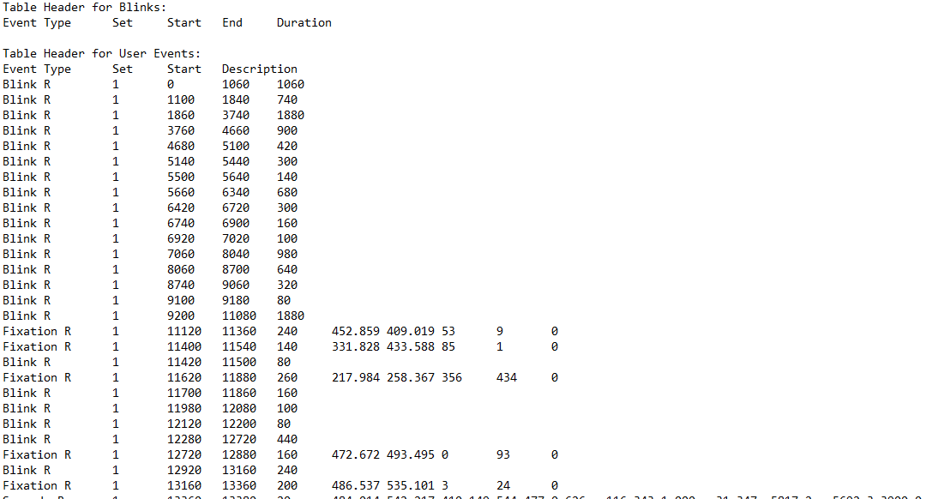
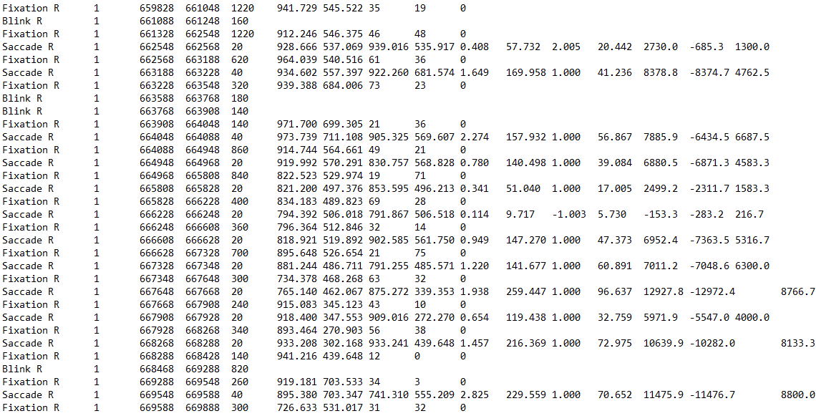
Main Experiment
Observations:
Eye-tracker calibration
Dark glasses frames
Cilia near to the pupil
Electrical Engineering, Mathematics and Computer Science Department - EEMCS
Notes:
The CR location in the eyes changes with head position relative to the static camera and it is used along with pupil location to determine the gaze point in the stimulus.

Slide 4
Main Experiment
Others observations:
Participants tired at the half of second session
Participants prefer to use the last break
Participants prefer 3 sessions than 2 sessions
Electrical Engineering, Mathematics and Computer Science Department - EEMCS
Notes:
The CR location in the eyes changes with head position relative to the static camera and it is used along with pupil location to determine the gaze point in the stimulus.

