Slide 1
Experiment 3 Summary
Alexandre Fieno
Electrical Engineering, Mathematics and Computer Science Department - EEMCS

Slide 2
Experiment: motivation
To study the characteristics of the most relevant artifacts present in digital videos:
Annoyance, visibility, interactions among artifacts and content dependence
To understand “how” artifacts affect quality, it is important in order to design good artifacts metrics
It focus in three different artifacts: blockiness, blurriness and packet loss
These are presented in several strengths, in several combinations and for seven original videos
Electrical Engineering, Mathematics and Computer Science Department - EEMCS

Slide 3
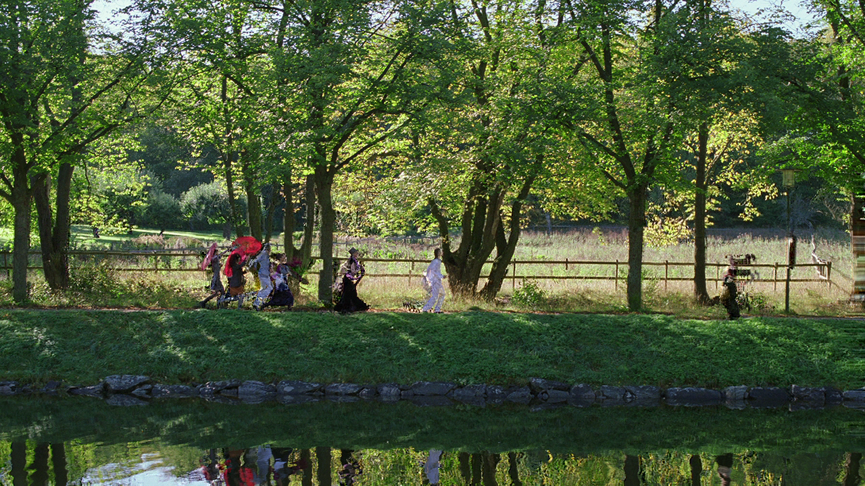
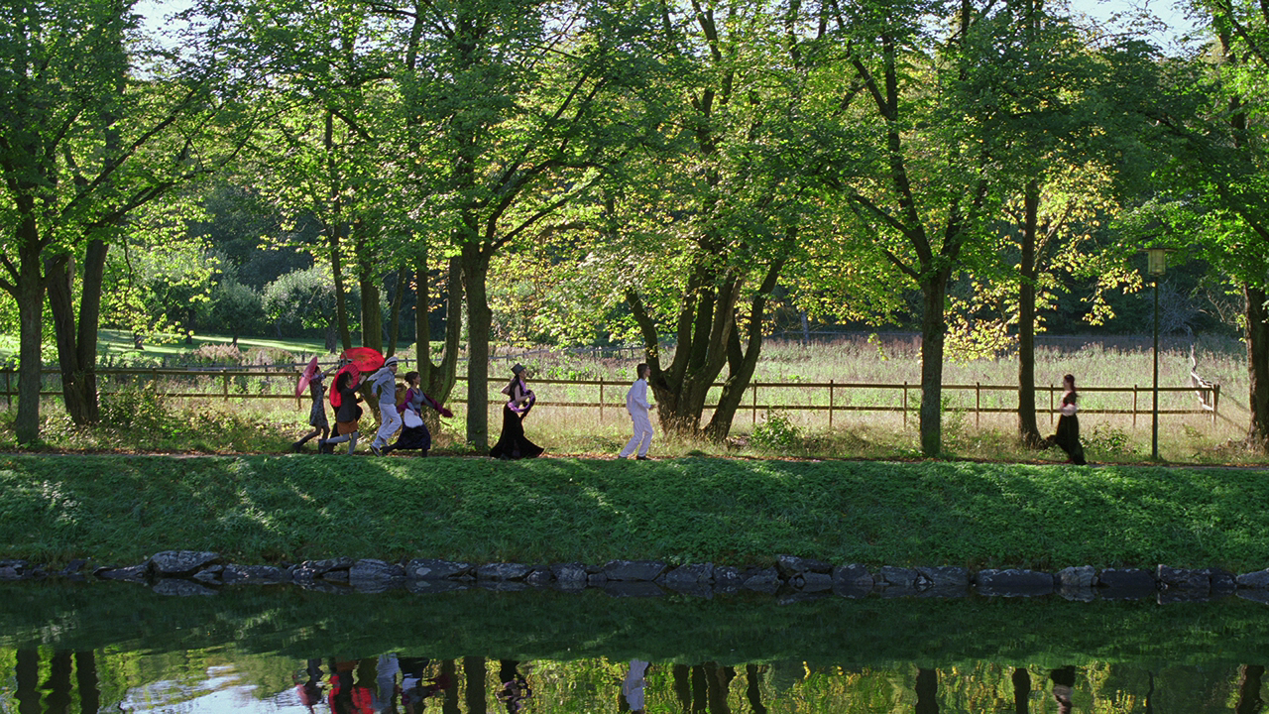
Experiment Artefacts: packet loss
Electrical Engineering, Mathematics and Computer Science Department - EEMCS

Slide 4
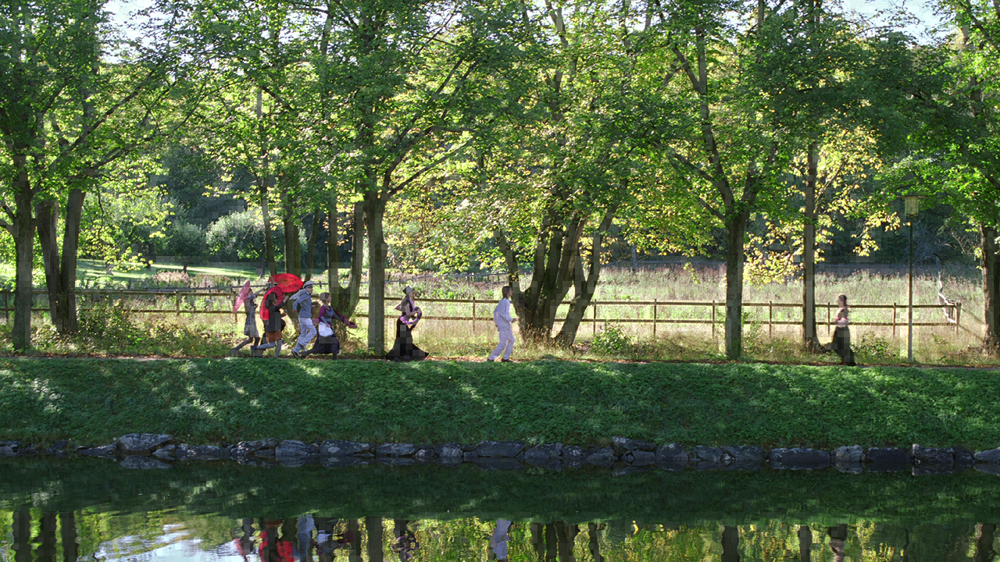
Experiment Artefacts: blockiness
Electrical Engineering, Mathematics and Computer Science Department - EEMCS

Slide 5
Experiment Artefacts: blurriness
Electrical Engineering, Mathematics and Computer Science Department - EEMCS

Slide 6
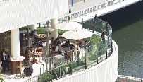
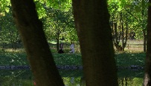
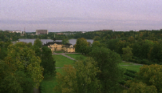
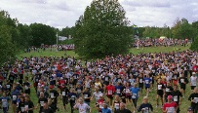
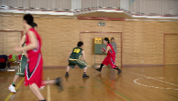
Experiment Setting: Stimuli
Original
720p
H.264 encoding
PSNR>70db, 120 Mbps
MPEG-2
120 Mbps
MPEG-2
120 Mbps
Combined Artefacts
Loss Ratio
(0.7%, 8.1%)
Blockiness and Blurriness Strength
(0.4%, 0.6%)
Video sequences with combined packet loss, blockiness and blurriness artefacts
Electrical Engineering, Mathematics and Computer Science Department - EEMCS

Slide 7
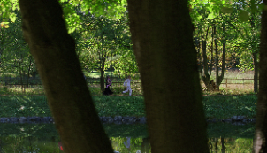
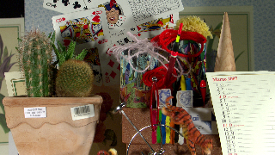
Experiment Setting: Protocol
23 participants
Single Stimulus setup (ITU BT.500)
1. calibration
2. Task free pristine videos
3. Training
4. Practice Trials
5. Scoring task
(140 videos)
3. How annoying were they?
2. “did you see impairments?”
1. video view
0 100
Yes/no
Electrical Engineering, Mathematics and Computer Science Department - EEMCS

Slide 8
Experiment Analysis: blurriness (among videos)
 | Ref. | Mean
Group | Blur(0.6) | Blur(0.6) + Pck (0.7) | Blur(0.6) + Pck (8.1) | Blur(0.4) + Pck (0.7) | Blur(0.4) + Pck (8.1)
ParkJoy | 32.74 | 44.61 | 59.43** | 24.91 | 51.52**
IntoTree | 39.70 | 35.48 | 49.74 | 14.70** | 34.30
ParkRun | 58.09 | 53.87 | 57.00 | 21.65** | 33.65**
Romeo | 12.74 | 26.57** | 56.57** | 11.04 | 51.13**
Cactus | 26.52 | 35.48 | 55.48** | 18.17 | 48.48**
Basketball | 32.13 | 35.57 | 62.70** | 28.00 | 63.52**
Barbecue | 25.26 | 36.35 | 50.65** | 17.87 | 40.57**
** p<.05 statistically significant
Electrical Engineering, Mathematics and Computer Science Department - EEMCS

Slide 9
Experiment Analysis: blockiness (among videos)
 | Ref. | Mean
Group | Bloc(0.6) | Bloc(0.6) + Pck (0.7) | Bloc(0.6) + Pck (8.1) | Bloc(0.4) + Pck (0.7) | Bloc(0.4) + Pck (8.1)
ParkJoy | 51.96 | 57.48 | 66.74** | 44.61 | 57.26
IntoTree | 44.43 | 50.17 | 65.09** | 37.70 | 58.96**
ParkRun | 53.35 | 54.09 | 63.09 | 29.91** | 49.17
Romeo | 45.57 | 52.87 | 67.43** | 44.17 | 62.87**
Cactus | 34.61 | 40.43 | 61.57** | 22.87** | 57.39**
Basketball | 49.52 | 57.09 | 72.78** | 47.30 | 64.52**
Barbecue | 60.61 | 62.87 | 72.17** | 42.52** | 64.13
** p<.05 statistically significant
Electrical Engineering, Mathematics and Computer Science Department - EEMCS

Slide 10
Experiment Analysis: packet loss (among videos)
 | Ref. | Mean
Group | Pck(8.1) | Bloc(0.6) | Blur(0.6)
ParkJoy | 38.70 | 51.96** | 32.74
IntoTree | 49.52 | 44.43 | 39.70
ParkRun | 20.52 | 53.35** | 58.09**
Romeo | 43.96 | 45.57 | 12.74**
Cactus | 27.78 | 34.61 | 26.52
Basketball | 43.57 | 49.52 | 32.13
Barbecue | 41.87 | 60.61** | 25.26**
** p<.05 statistically significant
Electrical Engineering, Mathematics and Computer Science Department - EEMCS

Slide 11
Experiment 3 End
Alexandre Fieno
Electrical Engineering, Mathematics and Computer Science Department - EEMCS

Slide 12
Experiment Analysis: blurriness (among videos)
 | Ref. | Mean
Group | Blur(0.6) | Blur(0.6) + Pck (0.7) | Blur(0.6) + Pck (8.1)
ParkJoy | 32.74 | 44.61 | 59.43**
IntoTree | 39.70 | 35.48 | 49.74
ParkRun | 58.09 | 53.87 | 57.00
Romeo | 12.74 | 26.57** | 56.57**
Cactus | 26.52 | 35.48 | 55.48**
Basketball | 32.13 | 35.57 | 62.70**
Barbecue | 25.26 | 36.35 | 50.65**
** p<.05 statistically significant
Electrical Engineering, Mathematics and Computer Science Department - EEMCS

Slide 13
Experiment Analysis: blurriness (among videos)
 | Ref. | Mean
Group | Blur(0.6) | Blur(0.4) + Pck (0.7) | Blur(0.4) + Pck (8.1)
ParkJoy | 32.74 | 24.91 | 51.52**
IntoTree | 39.70 | 14.70** | 34.30
ParkRun | 58.09 | 21.65** | 33.65**
Romeo | 12.74 | 11.04 | 51.13**
Cactus | 26.52 | 18.17 | 48.48**
Basketball | 32.13 | 28.00 | 63.52**
Barbecue | 25.26 | 17.87 | 40.57**
** p<.05 statistically significant
Electrical Engineering, Mathematics and Computer Science Department - EEMCS

Slide 14
Experiment Analysis: blockiness (among videos)
 | Ref. | Mean
Group | Bloc(0.6) | Bloc(0.6) + Pck (0.7) | Bloc(0.6) + Pck (8.1)
ParkJoy | 32.74 | 57.48 | 66.74**
IntoTree | 39.70 | 50.17 | 65.09**
ParkRun | 58.09 | 54.09 | 63.09
Romeo | 12.74 | 52.87 | 67.43**
Cactus | 26.52 | 40.43 | 61.57**
Basketball | 32.13 | 57.09 | 72.78**
Barbecue | 25.26 | 62.87 | 72.17**
** p<.05 statistically significant
Electrical Engineering, Mathematics and Computer Science Department - EEMCS

Slide 15
Experiment Analysis: blockiness (among videos)
 | Ref. | Mean
Group | Bloc(0.6) | Bloc(0.4) + Pck (0.7) | Bloc(0.4) + Pck (8.1)
ParkJoy | 51.96 | 44.61 | 57.26
IntoTree | 44.43 | 37.70 | 58.96**
ParkRun | 53.35 | 29.91** | 49.17
Romeo | 45.57 | 44.17 | 62.87**
Cactus | 34.61 | 22.87** | 57.39**
Basketball | 49.52 | 47.30 | 64.52**
Barbecue | 60.61 | 42.52** | 64.13
** p<.05 statistically significant
Electrical Engineering, Mathematics and Computer Science Department - EEMCS

Slide 16
Experiment Analysis: packet loss (among videos)
 | Ref. | Mean
Group | Pck(8.1) | Blur(0.4) + Pck (8.1) | Blur(0.6) + Pck (8.1)
ParkJoy | 38.70 | 51.52 | 59.43**
IntoTree | 49.52 | 34.30** | 49.74
ParkRun | 20.52 | 33.65** | 57.00**
Romeo | 43.96 | 51.13 | 56.57
Cactus | 27.78 | 48.48** | 55.48**
Basketball | 43.57 | 63.52** | 62.70**
Barbecue | 41.87 | 40.57 | 50.65
** p<.05 statistically significant
Electrical Engineering, Mathematics and Computer Science Department - EEMCS

Slide 17
Experiment Analysis: packet loss (among videos)
 | Ref. | Mean
Group | Pck(8.1) | Bloc(0.4) + Pck (8.1) | Bloc(0.6) + Pck (8.1)
ParkJoy | 38.70 | 57.26** | 66.74**
IntoTree | 49.52 | 58.96 | 65.09**
ParkRun | 20.52 | 49.17** | 63.09**
Romeo | 43.96 | 62.87** | 67.43**
Cactus | 27.78 | 57.39** | 61.57**
Basketball | 43.57 | 64.52** | 72.78**
Barbecue | 41.87 | 64.13** | 72.17**
** p<.05 statistically significant
Electrical Engineering, Mathematics and Computer Science Department - EEMCS

Slide 18
Experiment Analysis: original videos (among experiments)
 | Mean
Group | Exp. 1 | Exp. 2 | Exp. 3
ParkJoy | 1.36 | 2.81 | 0.00
IntoTree | 4.07 | 6.06 | 0.70
ParkRun | 1.93 | 3.50 | 1.30
Romeo | 0.00 | 6.13 | 0.00
Cactus | 0.14 | 4.50 | 0.43
Basketball | 0.36 | 6.44 | 0.83
Barbecue | 2.14 | 5.00 | 2.30
Electrical Engineering, Mathematics and Computer Science Department - EEMCS

Slide 19
Experiment Analysis: packet loss (between experiments)
 | Mean
Group | Exp. 1 | Exp. 3
ParkJoy | 80.00 | 38.70*
IntoTree | 91.29 | 49.52*
ParkRun | 43.36 | 20.52**
Romeo | 67.79 | 43.96**
Cactus | 69.79 | 27.78*
Basketball | 75.36 | 43.57*
Barbecue | 82.36 | 41.87*
* p<.01 statistically significant ** p<.05 statistically significant
Electrical Engineering, Mathematics and Computer Science Department - EEMCS

Slide 20
Experiment Analysis: blockiness (between experiments)
 | Mean
Group | Exp. 2 | Exp. 3
ParkJoy | 55.44 | 38.70**
IntoTree | 50.75 | 49.52
ParkRun | 53.75 | 20.52*
Romeo | 68.88 | 43.96**
Cactus | 51.06 | 27.78**
Basketball | 70.00 | 43.57*
Barbecue | 69.44 | 41.87**
* p<.01 statistically significant ** p<.05 statistically significant
Electrical Engineering, Mathematics and Computer Science Department - EEMCS

Slide 21
Experiment Analysis: blurriness (between experiments)
 | Mean
Group | Exp. 2 | Exp. 3
ParkJoy | 38.31 | 38.70
IntoTree | 37.31 | 49.52
ParkRun | 47.00 | 20.52**
Romeo | 23.75 | 43.96**
Cactus | 21.94 | 27.78
Basketball | 28.31 | 43.57**
Barbecue | 21.44 | 41.87**
* p<.01 statistically significant ** p<.05 statistically significant
Electrical Engineering, Mathematics and Computer Science Department - EEMCS

